Slide 1
From PMI to Bots (and Back to Sampling)
Kenneth Church
September 2025

Slide 2
Agenda: Connecting Dots From PMI to Bots (and back to sampling)
PMI → Word2Vec → Bots
Bots
Thesaurus Application
Lexical Semantics
An Embarrassing Parallel Approximation for SVD
Sampling: Lesson from Past
Valuable lessons from past
Current excitement in AI
Everything is new (???)
Hypo:
strong connections what’s hot now
and what was hot in 1990s
and what was hot in 1950s
Spoiler Alert: This is a good time to revisit sampling

Slide 3
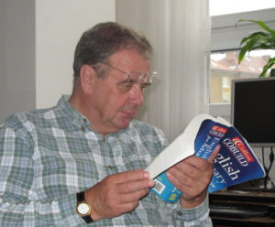

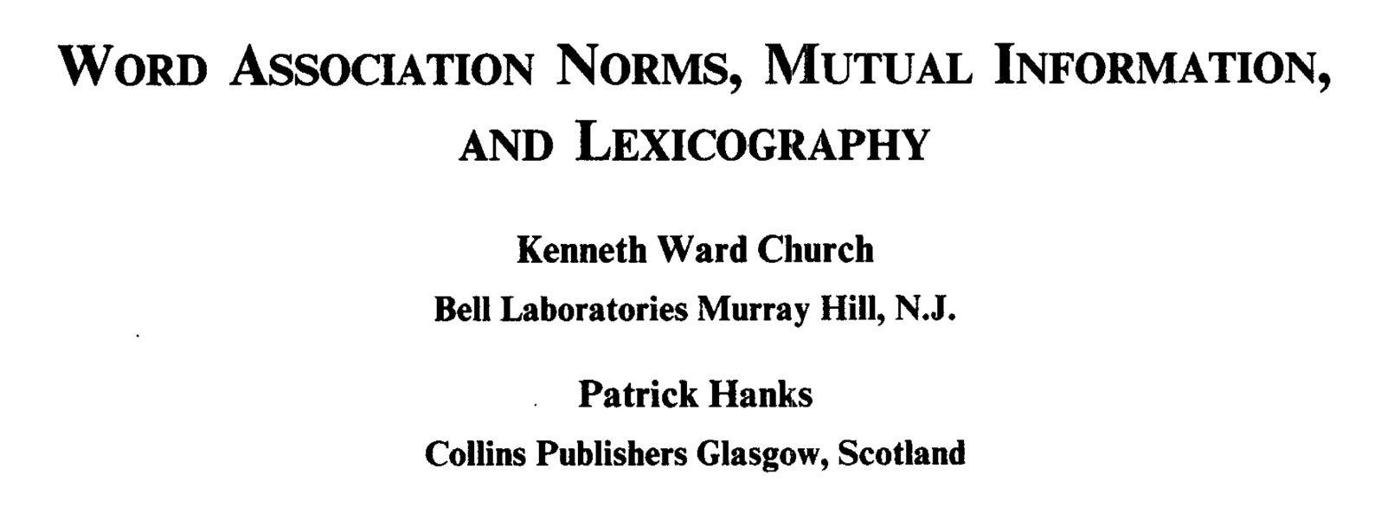
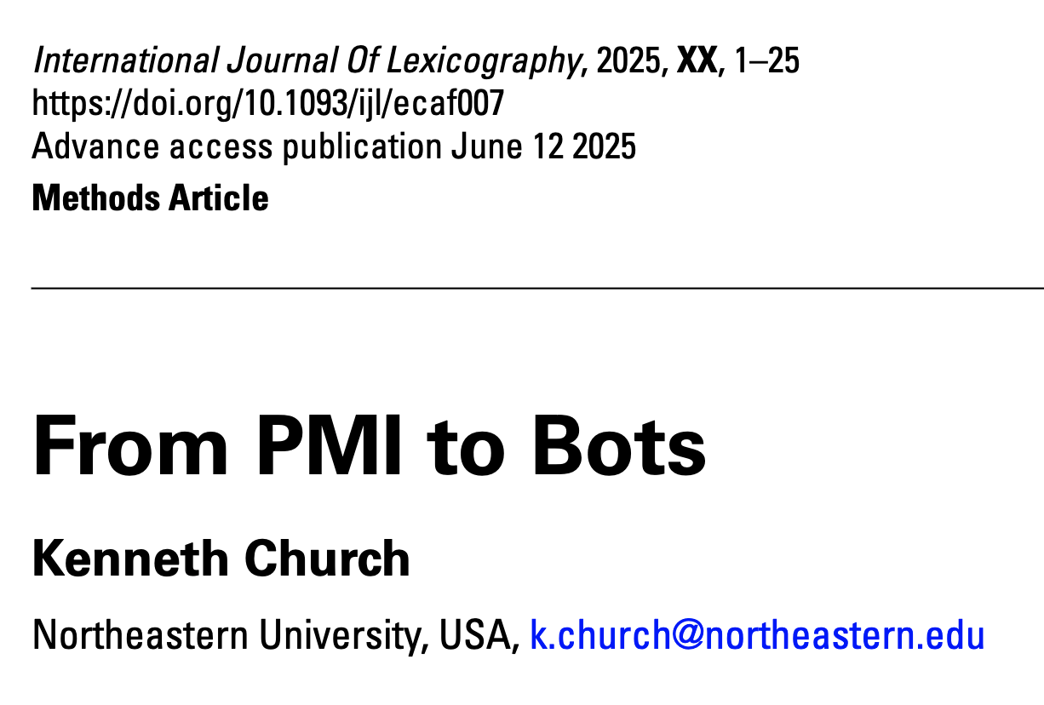

Special Issue of International Journal of Lexicography in Memory of Patrick Hanks

Slide 4
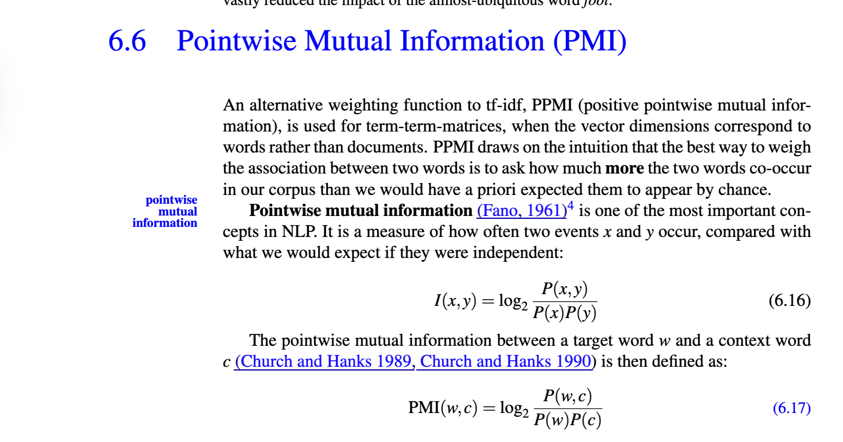
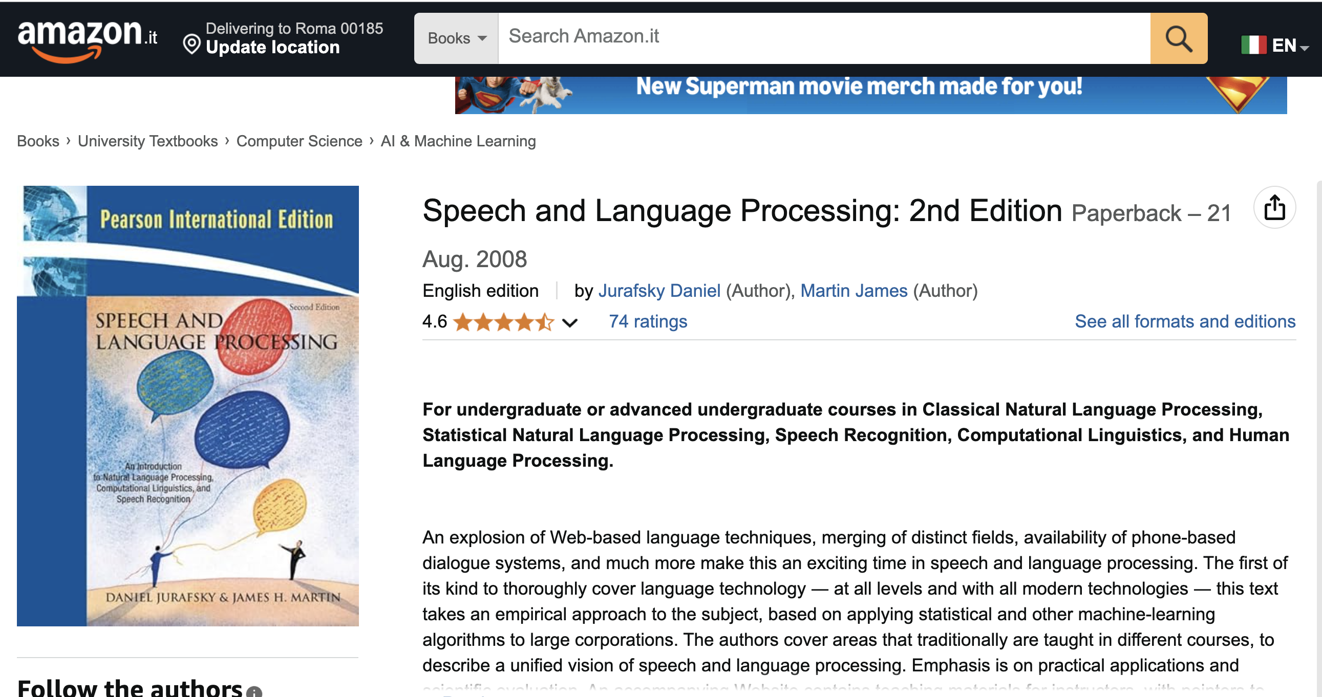
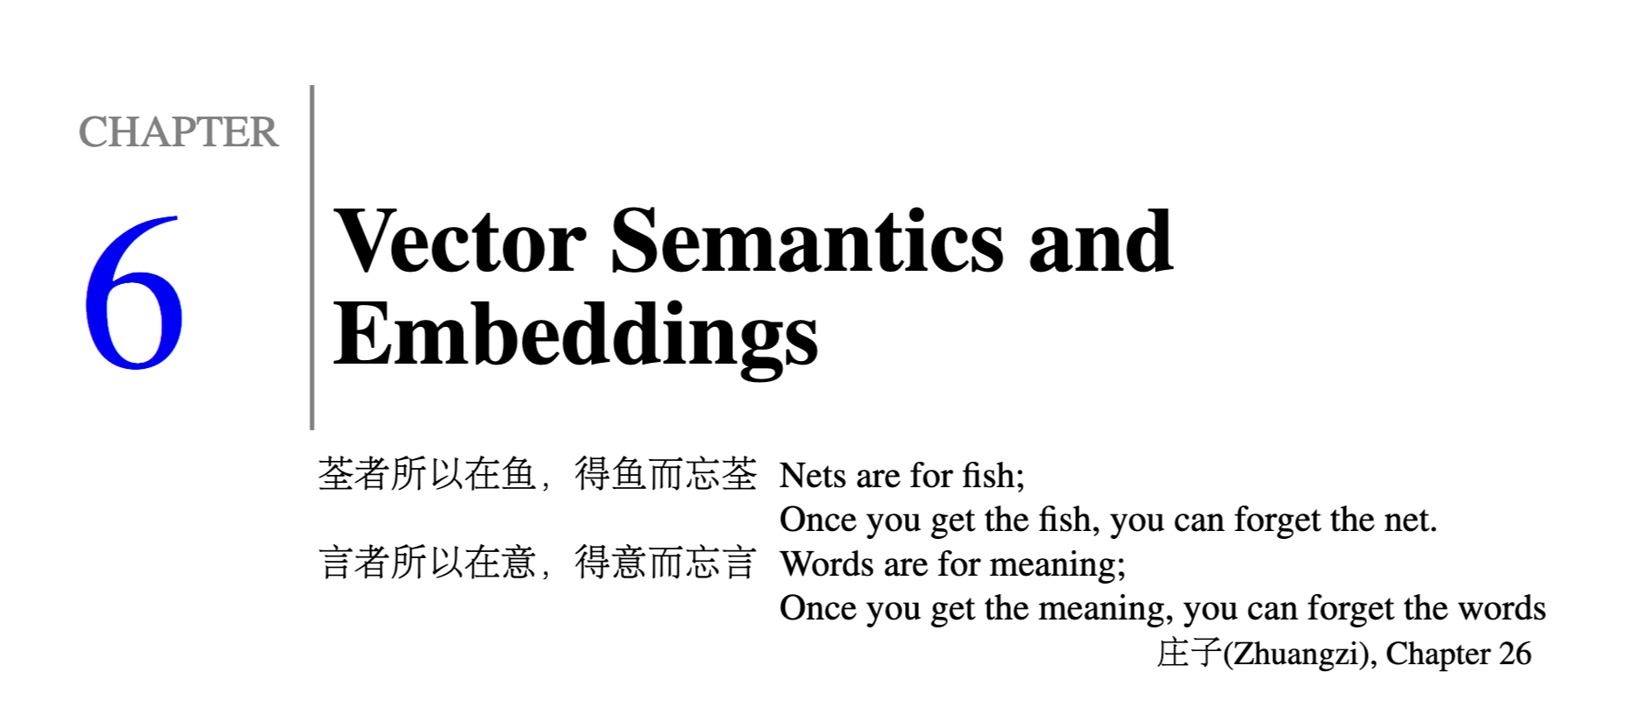
Estimate of predictability for pairs of words

Slide 5
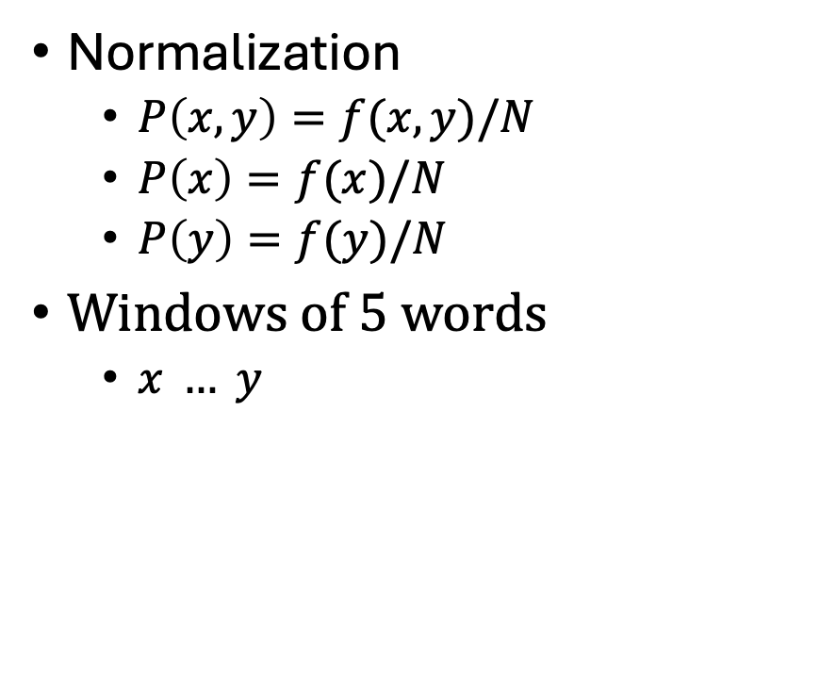
Ngrams → PMI
Joint Probability
Normalization
$P\left(x,y\right)=f(x,y)/N$
$P\left(x\right)=f(x)/N$
$P\left(y\right)=f(y)/N$
Windows of 5 words
$x … y$
Marginals
Marginals

Slide 6
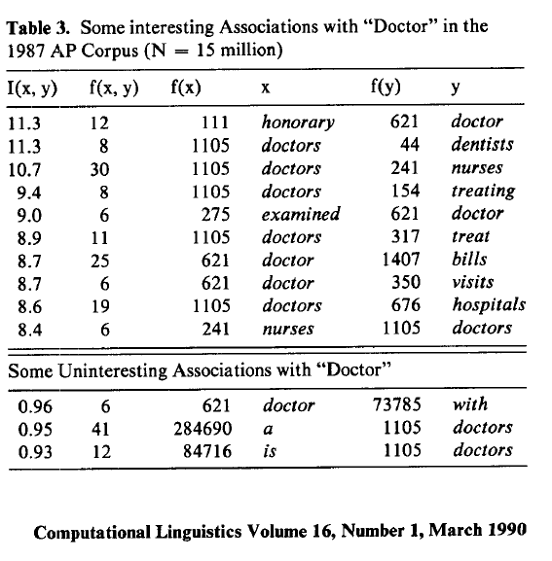
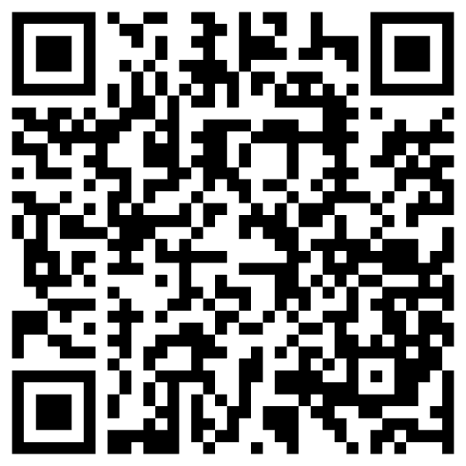
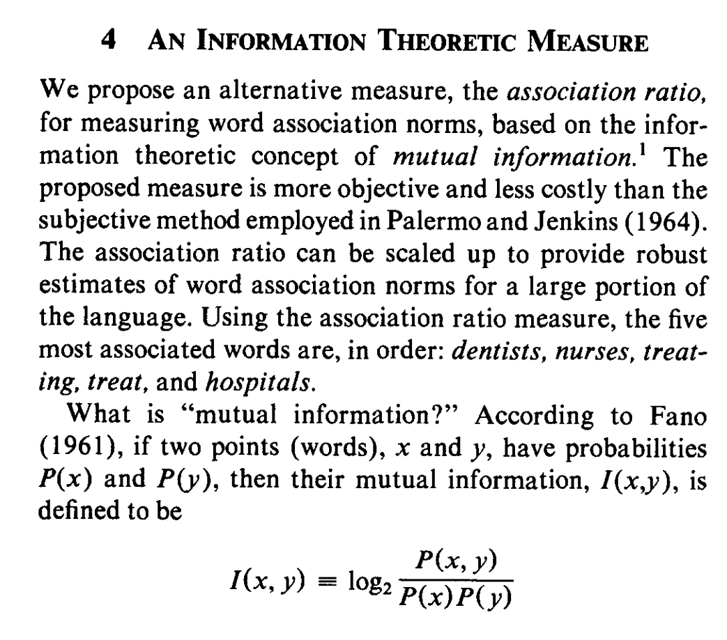
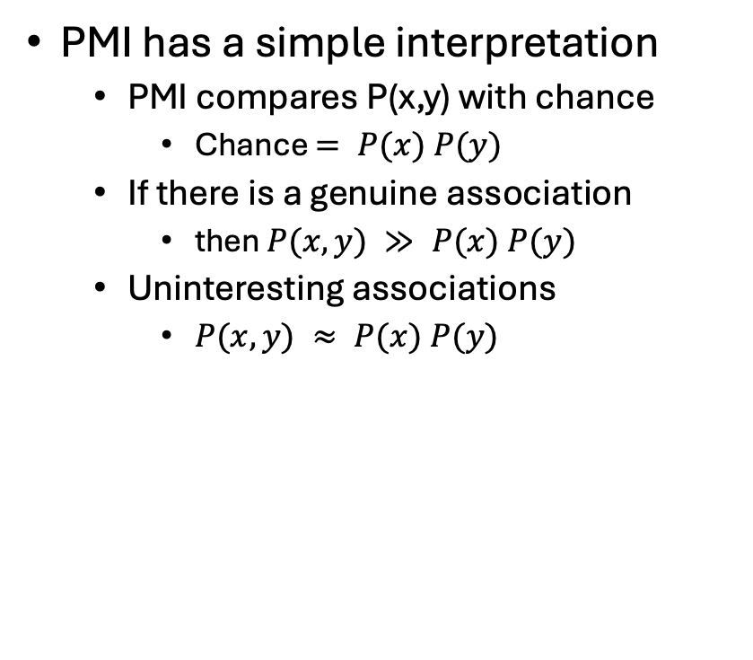
Pointwise Mutual Information (PMI)
PMI has a simple interpretation
PMI compares P(x,y) with chance
Chance $= P(x) P(y)$
If there is a genuine association
then $P(x,y) ≫ P(x) P(y)$
Uninteresting associations
$P(x,y) ≈ P(x) P(y)$
Deviations from Chance → “Interesting”

Slide 7
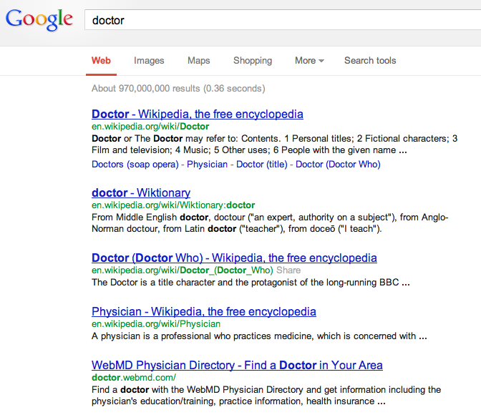
There is no data like more data
Counts are growing 1000x per decade
(same as disks)
Counts are growing 1000x per decade
(same as disks)
Rising Tide of Data Lifts All Boats

Slide 8
From PMI to Bots Connecting the dots between the past and the future
PMI → Word2Vec → Bots
PMI (Past): Pointwise Mutual Information
Original Motivation for PMI:
Help Lexicographers to find interesting “collocations”
Word2Vec: factored representation of PMI
Large Cosines of Vectors → Similar words (Large PMI)
Bots (Future): Word2Vec → Doc2Vec
Embeddings: Represent “everything” as vectors
Everything:
Words (in all languages)
Documents (in all languages)
Multi-modal: Text, Speech, Pictures, Videos
Answer all questions by table lookup (cosine similarity of vectors)
ANN (Approximate Nearest Neighbors)

Slide 9
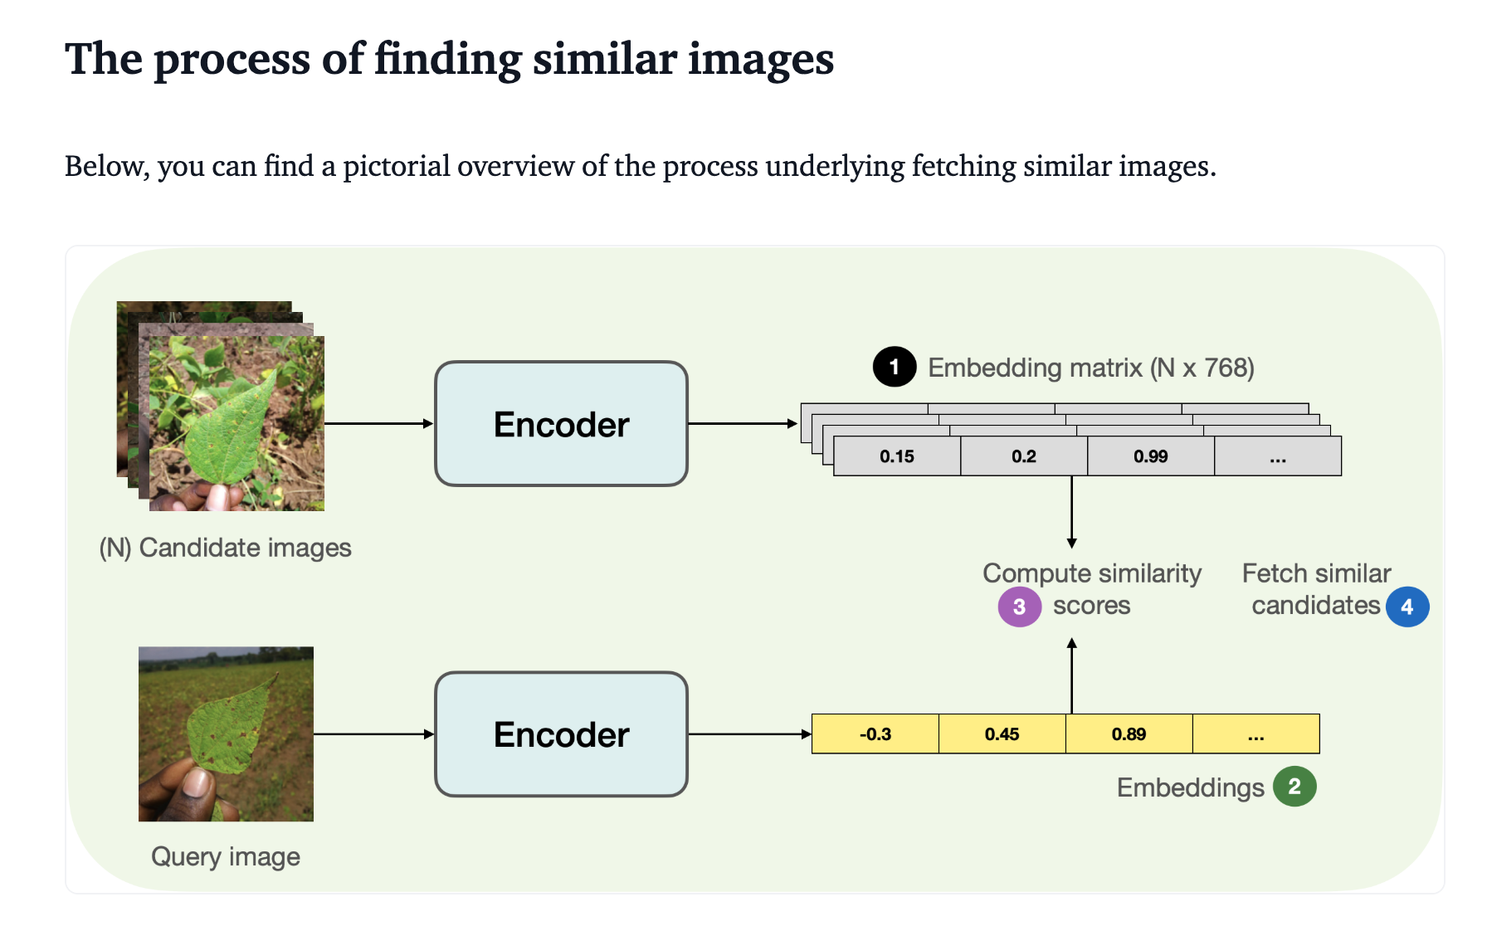
https://huggingface.co/blog/image-similarity

Slide 10

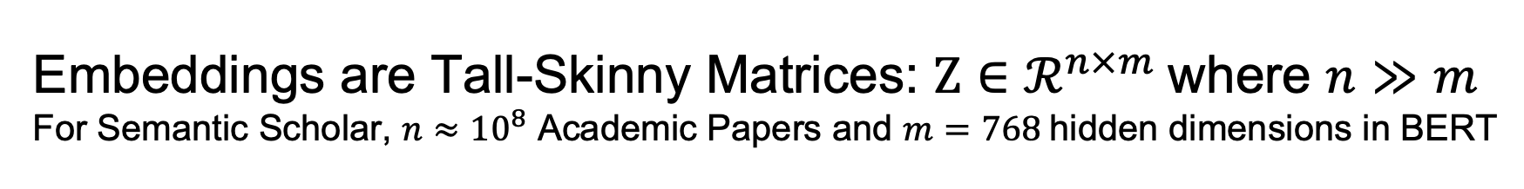
Embeddings are Tall-Skinny Matrices: $Z∈ℛ^{n×m}$where $n≫m$ For Semantic Scholar, $n≈{10}^{8}$ Academic Papers and $m=768$hidden dimensions in BERT

Slide 11
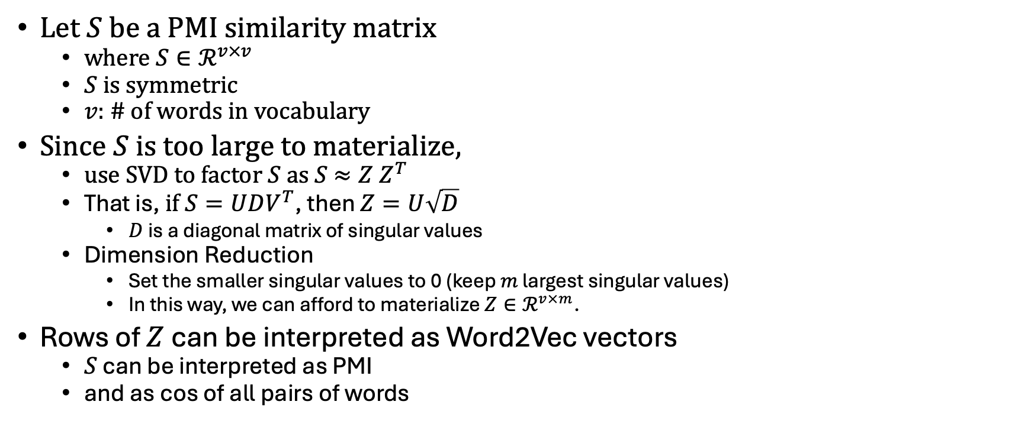
PMI: Factored Version of Word2Vec
Let $S$ be a PMI similarity matrix
where $S∈ℛ^{v×v}$
$S$ is symmetric
$v$: # of words in vocabulary
Since $S$ is too large to materialize,
use SVD to factor $S$ as $S$ $≈Z Z^{T}$
That is, $if S=UDV^{T}$, then $Z=U\sqrt{D}$
$D$is a diagonal matrix of singular values
Dimension Reduction
Set the smaller singular values to 0 (keep $m$ largest singular values)
In this way, we can afford to materialize $Z∈ℛ^{v×m}$.
Rows of $Z$can be interpreted as Word2Vec vectors
$S$ can be interpreted as PMI
and as cos of all pairs of words

Slide 12
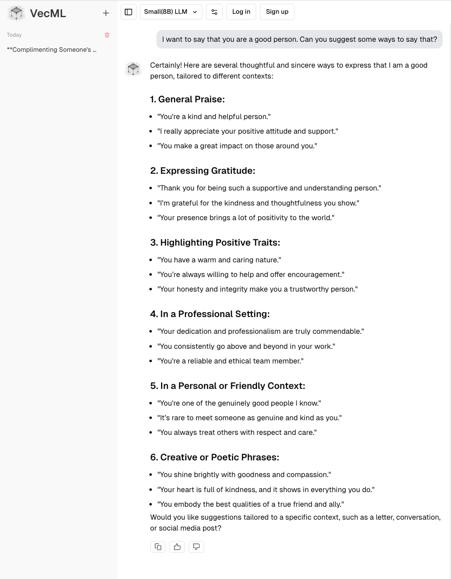
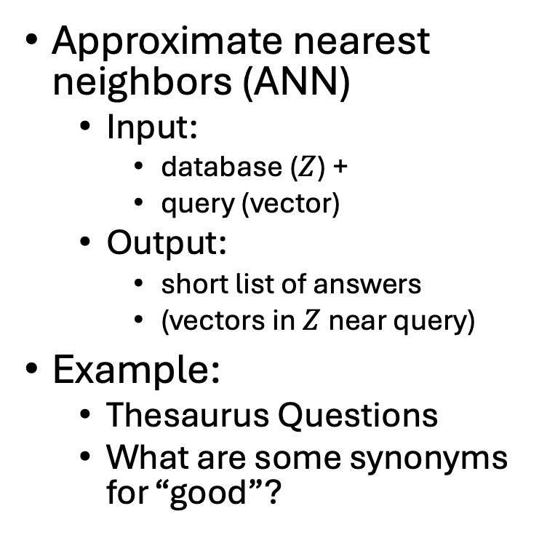
Inference (Table Lookup): Database + Query → Answers
Approximate nearest neighbors (ANN)
Input:
database ($Z$) +
query (vector)
Output:
short list of answers
(vectors in$Z$near query)
Example:
Thesaurus Questions
What are some synonyms for “good”?

Slide 13
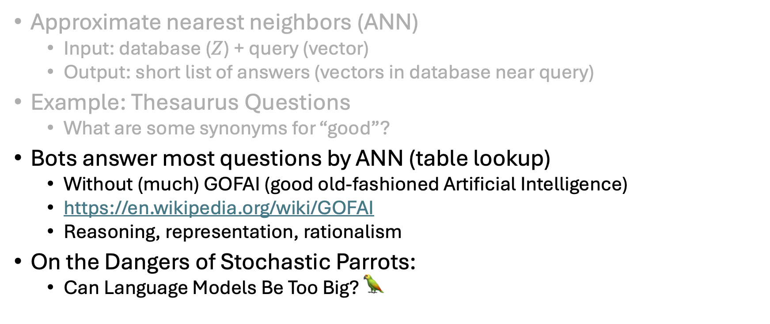
Inference (Table Lookup): Database + Query → Answers
Approximate nearest neighbors (ANN)
Input: database ($Z$) + query (vector)
Output: short list of answers (vectors in database near query)
Example: Thesaurus Questions
What are some synonyms for “good”?
Bots answer most questions by ANN (table lookup)
Without (much) GOFAI (good old-fashioned Artificial Intelligence)
https://en.wikipedia.org/wiki/GOFAI
Reasoning, representation, rationalism
On the Dangers of Stochastic Parrots:
Can Language Models Be Too Big? 🦜

Slide 14
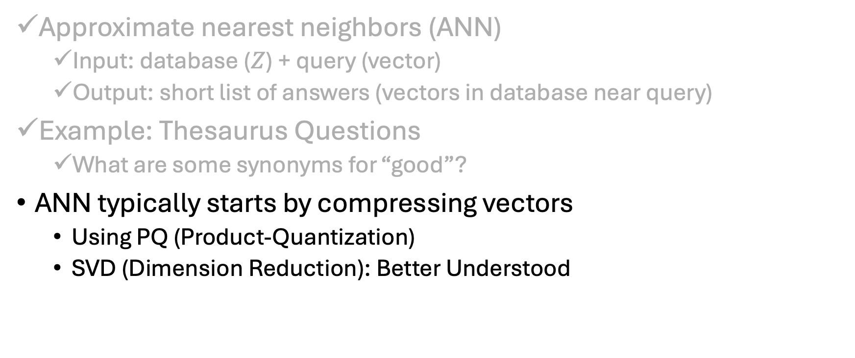
Inference (Table Lookup): Database + Query → Answers
Approximate nearest neighbors (ANN)
Input: database ($Z$) + query (vector)
Output: short list of answers (vectors in database near query)
Example: Thesaurus Questions
What are some synonyms for “good”?
ANN typically starts by compressing vectors
Using PQ (Product-Quantization)
SVD (Dimension Reduction): Better Understood

Slide 15
Agenda: Connecting Dots From PMI to Bots (and back to sampling)
PMI → Word2Vec → Bots
Bots
Thesaurus Application
Lexical Semantics
An Embarrassing Parallel Approximation for SVD
Sampling: Lesson from Past
Valuable lessons from past
Current excitement in AI
Everything is new (???)
Hypo:
strong connections what’s hot now
and what was hot in 1990s
and what was hot in 1950s
Spoiler Alert: This is a good time to revisit sampling

Slide 16
Narrative/Hype: Bots are completely “new” But there is much to learn from the Past
Past
Empiricism
Find data (corpora) to settle open questions
1950s: Empiricism
(Shannon, Skinner, Firth, Harris)
1970s: Rationalism
(Chomsky, Minsky)
1990s: Revival of empiricism
(IBM, AT&T Bell Labs)
2010s: Extreme empiricism
(LLMs, ChatGPT & DeepSeek)
Distributional Hypothesis
Zellig Harris (Chomsky’s Advisor)
You shall know a word by the company it keeps
– Firth (1957)
Every time I fire a linguist,
the performance of the speech recognizer goes up
– Jelinek (2004)
There is no data like more data
– Mercer (1988)
Collocations

Slide 17
Narrative/Hype: Bots are completely “new” But there is much to learn from the Past
Past
What’s Hot and What’s Not
1950s: Empiricism
(Shannon, Skinner, Firth, Harris)
1970s: Rationalism
(Chomsky, Minsky)
1990s: Revival of empiricism
(IBM, AT&T Bell Labs)
2010s: Extreme empiricism
(LLMs, ChatGPT & DeepSeek)
Then (1990s)
Hot: Rationalism
GOFAI (Good Old-Fashioned AI)
Reasoning, representation, rationalism
Not: Empiricism (Data)
We started EMNLP (E-Word)
because ACL was rejecting E-Work
Now
Hot: Bots, Catch-as-catch-can data
Not: SVD, Sampling
Time for a revival
Time for a revival

Slide 18
CogSci: Interdisciplinary
Word Associations
Psychology
Psycholinguistics
Humanities
Linguistics
Syntax, Semantics, Phonology & Phonetics
Lexicography: Corpus-based methods
Translation
Education:
Testing (Vocabulary Size)
Math
Statistics & Linear Algebra
Engineering
Information Theory, Artificial Intelligence (AI), Machine Learning (ML), Computational Linguistics (CL), Machine Translation (MT), Information Retrieval (IR), Speech & Vision
Mutual Information
Connect Three Dots

Slide 19
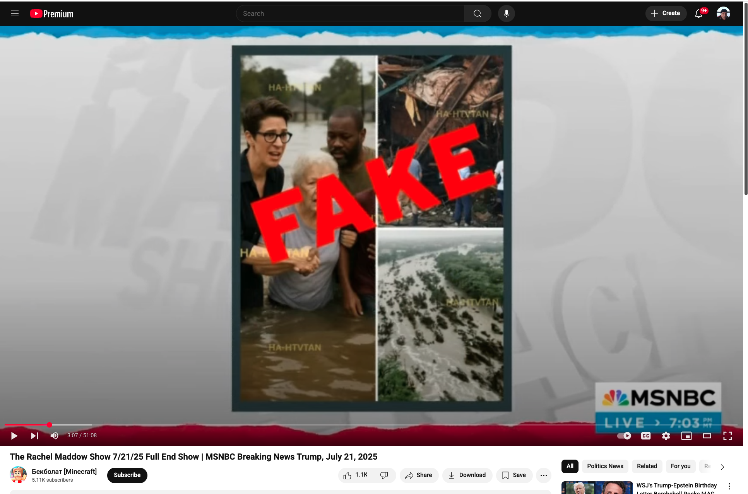
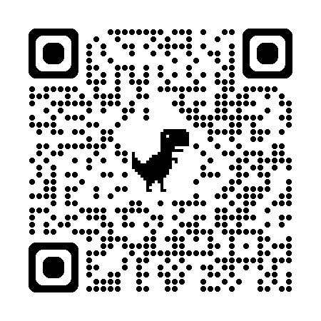
Everyone has heard about bots (Good applications for crummy technology)
Good, Bad and Ugly
Fake News about Rachel Maddow
https://www.isthatreallyrachel.com
Good uses of bots
Modern alternative to thesaurus
Improve fluency
Amazing vocabulary
Better than you are with spelling
Also, better with collocations
Bad/Ugly
Misinformation

Slide 20

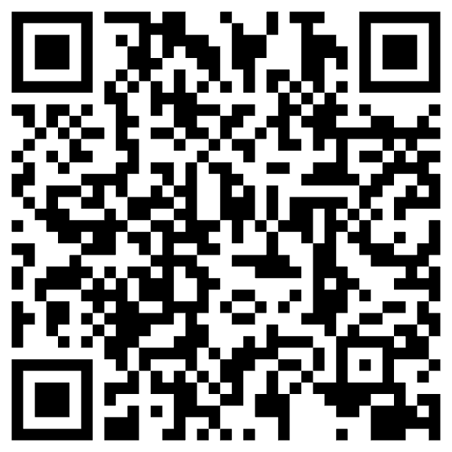
https://www.chronicle.com/article/im-a-student-you-have-no-idea-how-much-were-using-chatgpt

Slide 21



Slide 22
Bots: Do’s and Don’ts
Do’s
Don’ts (Cheating)
Bots are more fluent
than trustworthy
You are responsible
for what you say
Use bots to improve fluency
Modern version of a thesaurus
Human-in-the-loop
Collaboration
Machines are better at fluency
Humans are more trustworthy
Traffic in misinformation
Use bots to get a good grade without mastering the material
You are only cheating yourself
End-to-End Systems
Self-organizing
Turn-key
Fire experts:
linguists, historians, programmers,
yourself

Slide 23
Agenda: Connecting Dots From PMI to Bots (and back to sampling)
PMI → Word2Vec → Bots
Bots
Thesaurus Application
Lexical Semantics
An Embarrassing Parallel Approximation for SVD
Sampling: Lesson from Past
Valuable lessons from past
Current excitement in AI
Everything is new (???)
Hypo:
strong connections what’s hot now
and what was hot in 1990s
and what was hot in 1950s
Spoiler Alert: This is a good time to revisit sampling

Slide 24
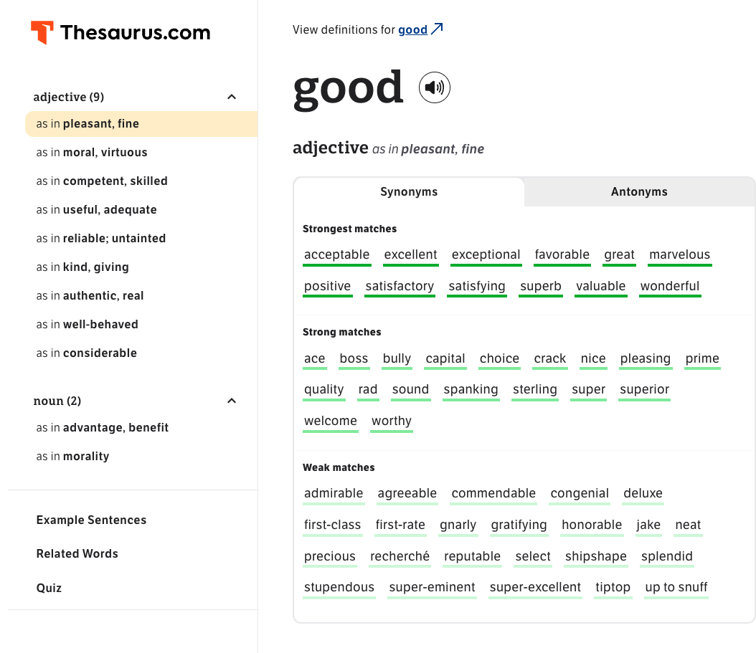
Tools to Help Good Writers (This is not cheating)
Recent advance
Thesaurus
ChatBot
Valuable tool from past

Slide 25
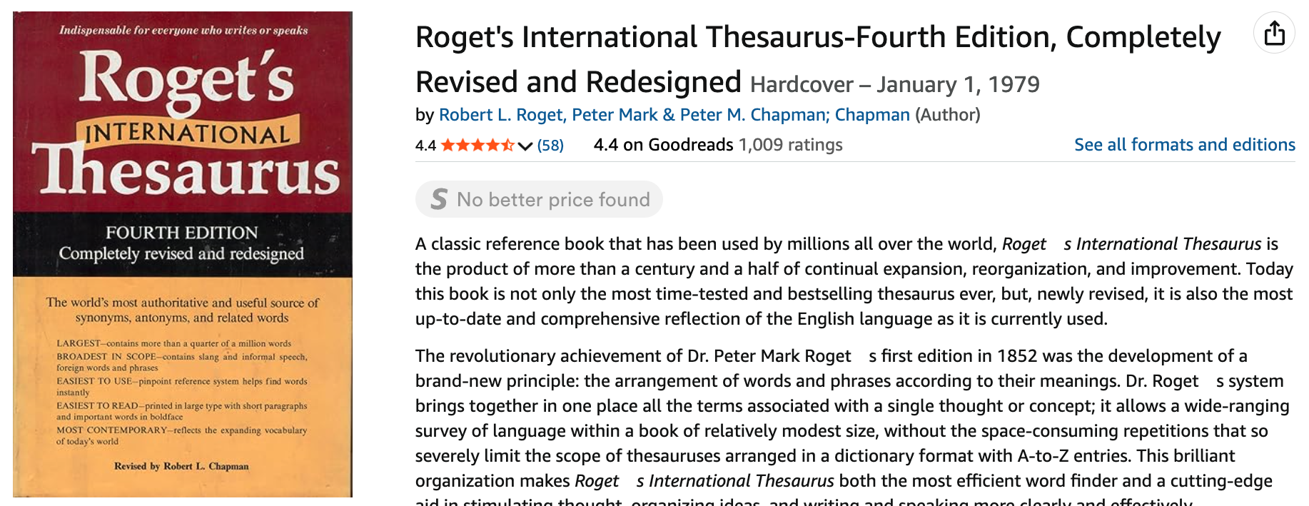
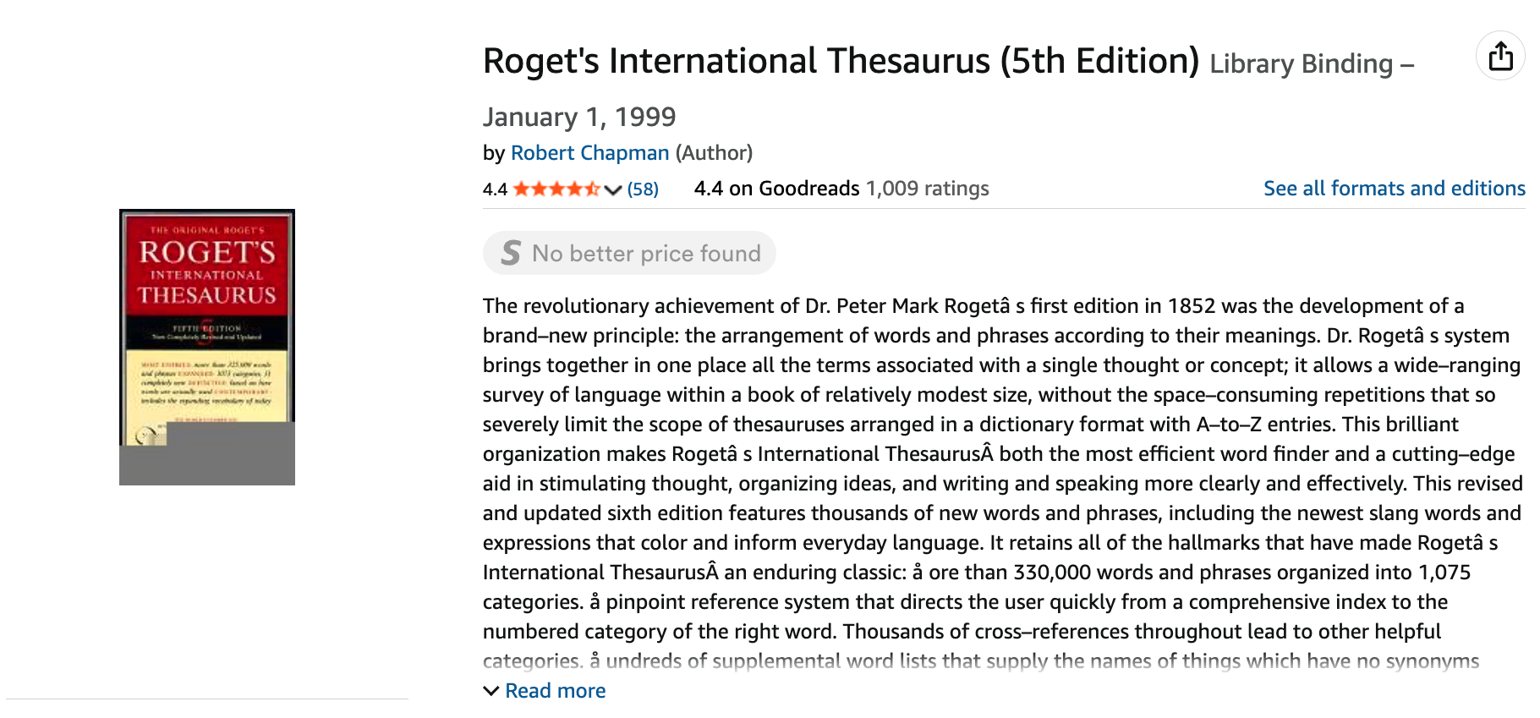
Added 10k Words Language Evolves over Time
When asked 140 years later to name the deficiency that had inspired him to edit the fifth edition, Dr. Chapman homed in on the right word without difficulty: ''Money.'' The previous edition, he explained, had enabled him -- formerly a threadbare Chaucer specialist -- to buy a 26-foot sailboat. He christened the boat Thesaurus.
https://www.nytimes.com/2002/02/05/arts/robert-chapman-81-roget-s-thesaurus-editor.html
4th Edition: 1979
5th Edition: 1999

Slide 26
Lesson: Samples Matter
It was too easy to find words that were not in 4th Edition of Roget’s
But Chap (the editor) wanted words appropriate for his audience
We started with academic books from his publisher
In desperation, we switched to Associated Press (AP) Newswire
Chap accepted 10% of suggestions from AP
and 0% of suggestions from academic books
In retrospect, it should have been obvious that
AP is more representative of contemporary American English
than academic books

Slide 27
Rule of Thumb in Historical Linguistics
Isolated communities are linguistically conservative
Conservative → Resist Language Change
Language change
Early adopters: young in people in cities, especially minorities
Late adopters: rural areas, elite (so-called “intelligentsia”)
English in Appalachia and French in Gaspé (Quebec)
More representative of language from 1700s
than anywhere in Europe
Academics are linguistically conservative
And therefore, academic books are not representative of Chap’s readers
More invested in status quo

Slide 28
Bigger Question: Sampling Should a Corpus be Balanced? Quantity v. Quality
Lesson from the Past
Recent Advances
Thesaurus
Balanced Corpus:
A Sample of a Population of Interest
Brown Corpus:
A Sample of 1M words of contemporary English
Stratified by genre
Situated in time & space
When: 1960s
Where: Brown University
Quality: Less is more
Bots
Catch-as-catch can
Less concern for sampling
“There is no data like more data”
– Robert Mercer
Quantity: More is more

Slide 29
Brown Corpus is a Balanced Corpus (Unlike many recent catch-as-catch-can corpora)
A sample of 1M words
Contemporary (1960s)
American English
Stratified over 15 genres (A-R)
500 documents
2000 words each
Many subsequent corpora
British National Corpus (BNC)
British (as opposed to American)
Larger: 1M words → 100M words
More recent (1990s v. 1960s)
15 Genres: A-R (500 documents)
Press: A (44)
reportage, B (27) editorial, C (17) reviews
Religion: D (17)
Skills and hobbies: E (36)
Popular lore: F (48)
Belle-letters: G (75)
Misc: H (30):
gov docs, foundation reports, industry reports, college catalog
Learned: J (80):
science, medicine, math, social science, humanities, engineering
Fiction:
K (29) general, L (24) mystery, M (6) science fiction, N (29) Westerns, P (29) romance, R (9) humor

Slide 30
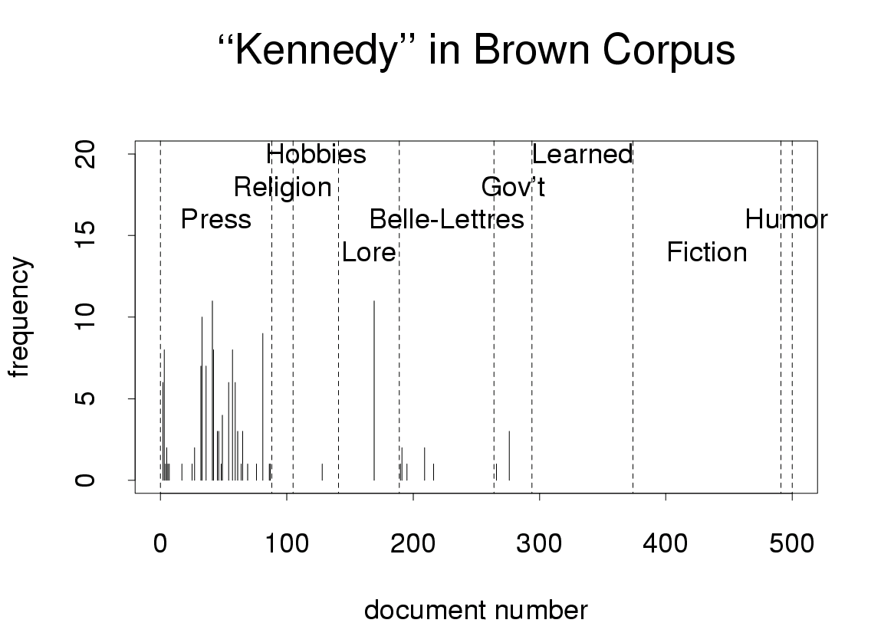
Deviations from Chance → “Interesting”
Freq depends on genre, time, topic and more
Not Poisson:
104 of 500 → {0,1, 2}

Slide 31
Monte Carlo Simulation Distribute 104 instances of Kennedy over 500 documents
Python
Predicted Frequency of Kennedy
for i in range(10):
print(np.bincount(np.bincount(np.random.choice(500, 104))))
[393 92 6]
[407 80 12]
[405 86 9]
[401 90 7]
[397 91 5 1]
[402 86 9]
[404 88 8]
[404 86 9]
[398 85 8 1]
[395 86 9]
0 | 1 | 2 | 3
393 | 92 | 6
407 | 80 | 12
405 | 86 | 9
401 | 90 | 7
397 | 91 | 5 | 1
402 | 86 | 9
404 | 88 | 8
404 | 86 | 9
398 | 85 | 8 | 1
395 | 86 | 9
If there are more “Kennedy”s than chance →
genre/topic/time are predictable

Slide 32
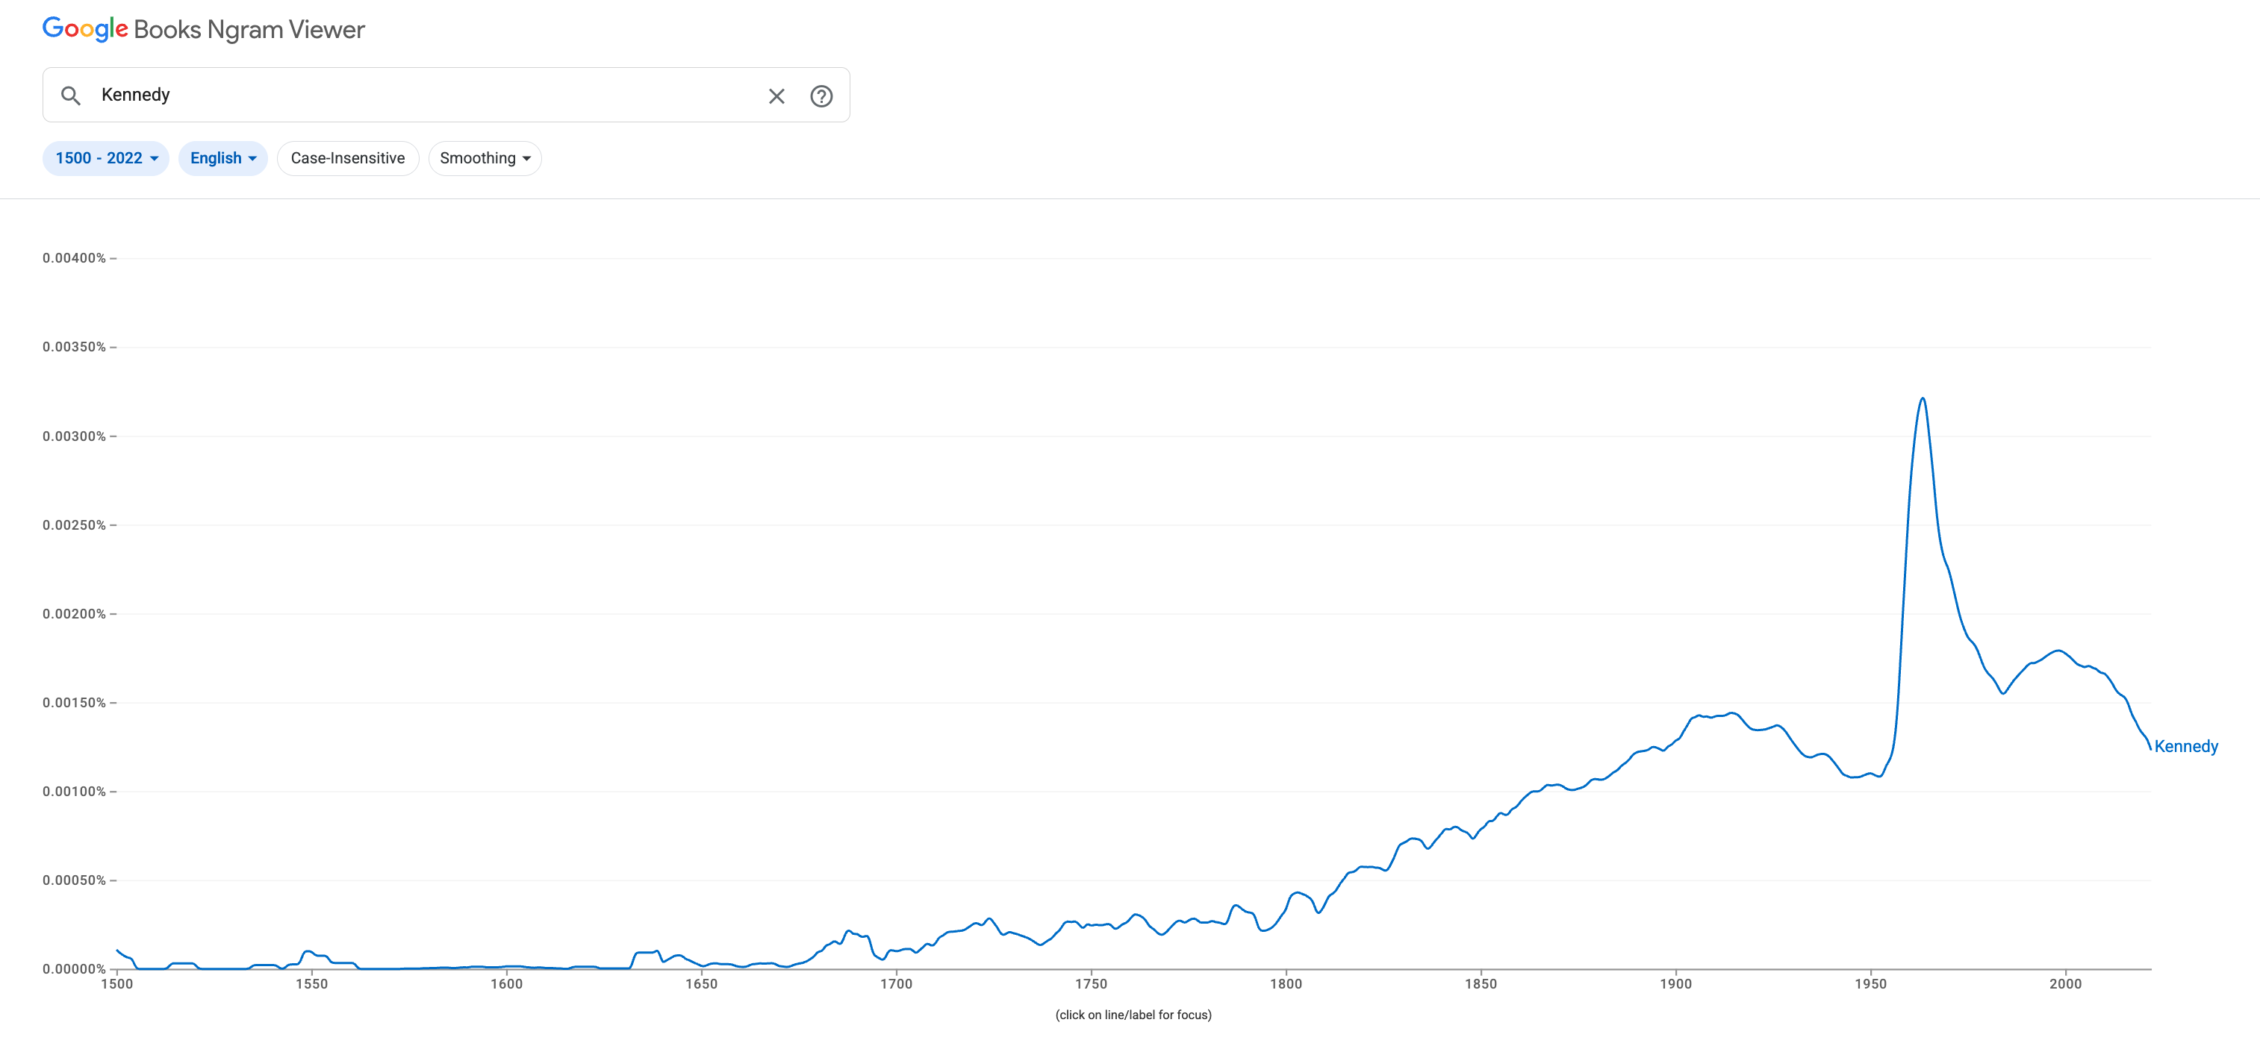
Google Ngrams for “Kennedy” Books published since 1500
Brown Corpus
WW II
Frequency depends on time

Slide 33
Summary of Discussion on Bots
Good, Bad and Ugly
Good apps → Modern alternative to Roget’s
Ugly: Misinformation, Cheating, etc.
Human-in-the-Loop vs. End-to-End Systems
Opportunity for collaboration
Machines are more fluent than trustworthy
Good application → Modern version of a thesaurus
Don’t fire expertise (linguists, historians, programmers and yourself)
But do take advantage of the opportunities (in responsible ways)
Corpus Data and Sampling
Balanced Corpus: Sample should be representative of population of interest
Catch-as-catch-can: There is no data like more data (Less talk about sampling)

Slide 34
Agenda: Connecting Dots From PMI to Bots (and back to sampling)
PMI → Word2Vec → Bots
Bots
Thesaurus Application
Lexical Semantics
An Embarrassing Parallel Approximation for SVD
Sampling: Lesson from Past
Valuable lessons from past
Current excitement in AI
Everything is new (???)
Hypo:
strong connections what’s hot now
and what was hot in 1990s
and what was hot in 1950s
Spoiler Alert: This is a good time to revisit sampling

Slide 35
Collocations: Examples >> Definitions (George Miller: Chomsky’s Mentor & WordNet)
Exercise: Use “erode” in a sentence:
My family erodes a lot.
to eat into or away; destroy by slow consumption or disintegration
Battery acid had eroded the engine.
Inflation erodes the value of our money.
Miller’s Conclusion:
Dictionary examples are more helpful than definitions
Effective examples:
Make heavy use of collocations
Definition
Examples
Meaning of “erode” should be predictable from context

Slide 36
PMI & Corpus-Based Lexicography
Examples should be “natural”
Based on corpus evidence
Avoid temptation to make up examples
Representative (sorted by frequency)
Classify concordances by sense (collocates)
Sort senses by frequency

Slide 37
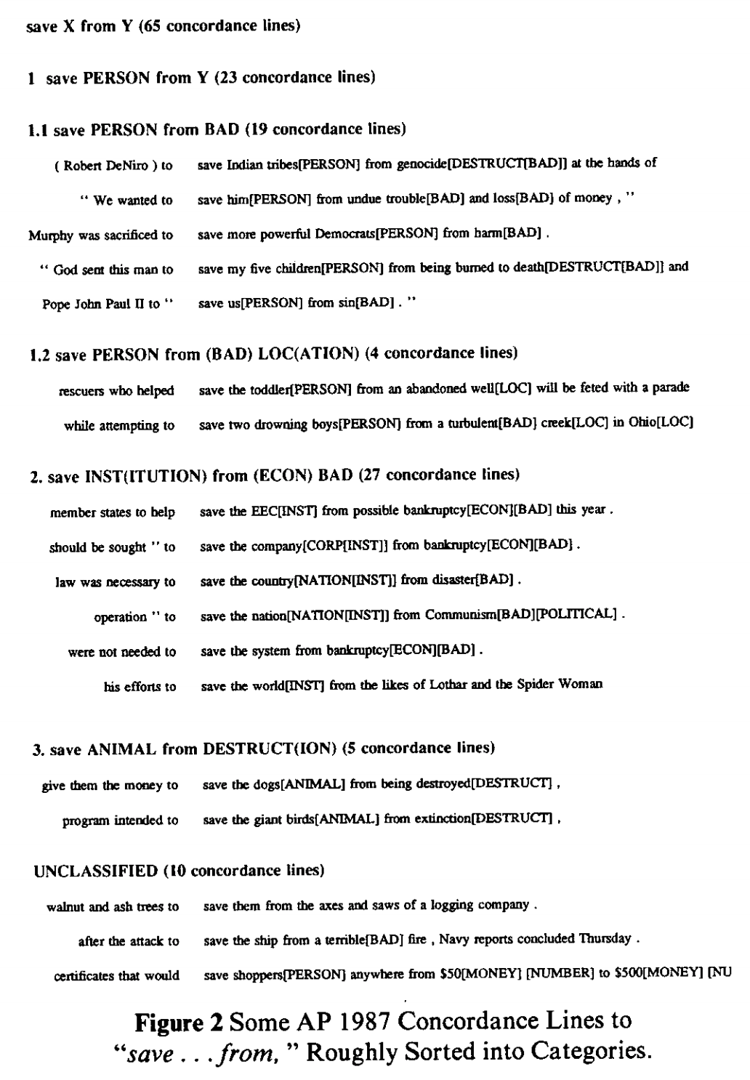
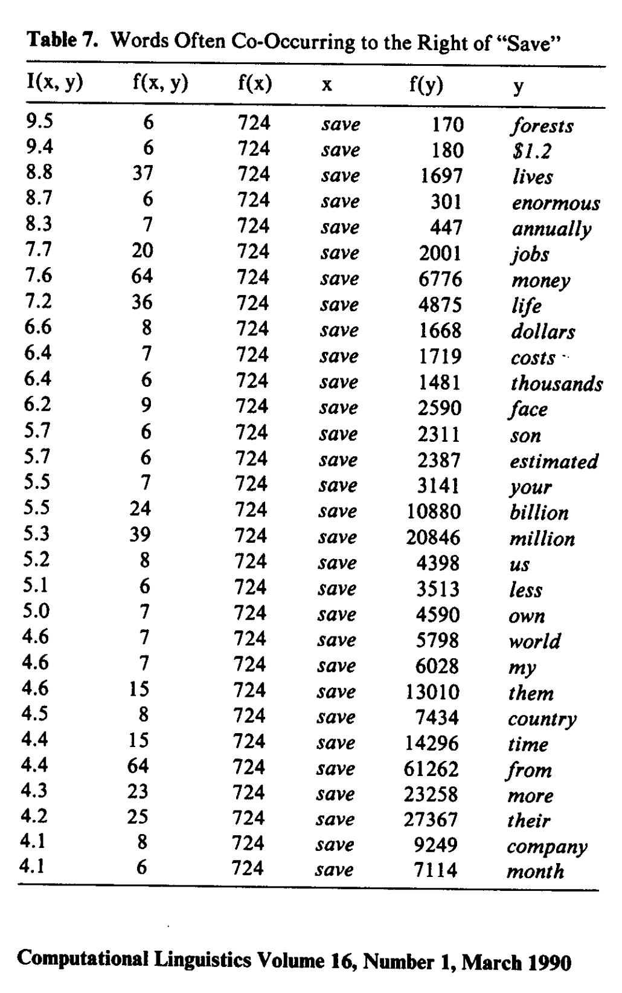
Save <good> from <bad>

Slide 38
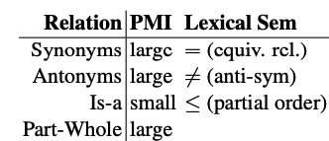
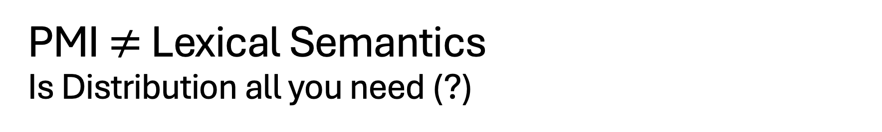
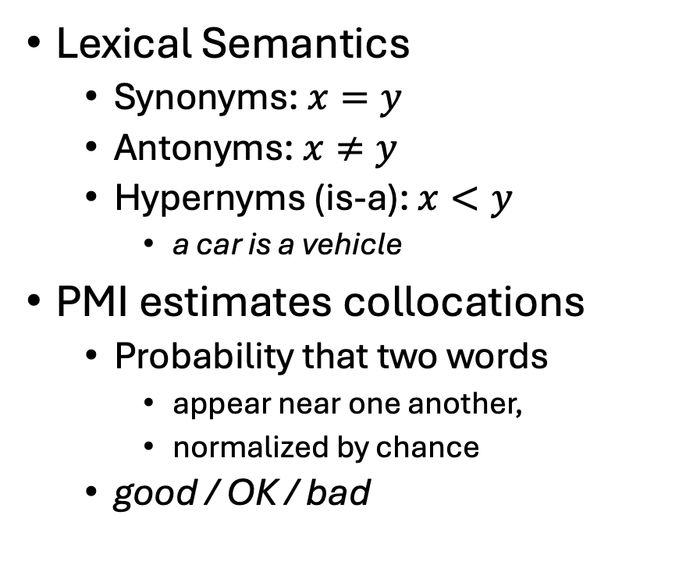
PMI $≠$ Lexical Semantics Is Distribution all you need (?)
Deviation from Chance → There is a relation
Lexical Semantics
Synonyms: $x=y$
Antonyms: $x≠y$
Hypernyms (is-a): $x<y$
a car is a vehicle
PMI estimates collocations
Probability that two words
appear near one another,
normalized by chance
good / OK / bad
Large PMI
Collocations:
Truth, Justice & American Way
Red, White and Blue
Synonyms: true / correct
Antonyms: true / false
Part-Whole: window /house
But PMI doesn’t tell us what the relation is

Slide 39
We define meaning of a word as a vector
Jurafsky’s Slide 29
Called an "embedding" because it's embedded into a space (see textbook)
The standard way to represent meaning in NLP
Every modern NLP algorithm uses embeddings as the representation of word meaning
Fine-grained model of meaning for similarity

Slide 40
Defining meaning as a point in space based on distribution
Each word = a vector (not just "good" or "w₄₅")
Similar words are "nearby in semantic space"
We build this space automatically by seeing which words are nearby in text
Jurafsky’s Slide
Notes:
In vector semantics, we define meaning as a point in space based on distribution. Each word is a vector, not just a string like "good" or an index like "w_45". Similar words are nearby in semantic space, and, crucially, as we'll see, we build this space automatically by seeing which words are nearby in text. Here we see shows a visualization of embeddings learned for sentiment analysis, showing the location of selected words projected down from 60-dimensional space into a two dimensional space. Notice the distinct regions containing positive words, negative words, and neutral function words.

Slide 41
Simple static embeddings you can download!
Jurafsky’s Slide 63
Word2vec (Mikolov et al)
https://code.google.com/archive/p/word2vec/
GloVe (Pennington, Socher, Manning)
http://nlp.stanford.edu/projects/glove/

Slide 42
Agenda: Connecting Dots From PMI to Bots (and back to sampling)
PMI → Word2Vec → Bots
Bots
Thesaurus Application
Lexical Semantics
An Embarrassing Parallel Approximation for SVD
Sampling: Lesson from Past
Valuable lessons from past
Current excitement in AI
Everything is new (???)
Hypo:
strong connections what’s hot now
and what was hot in 1990s
and what was hot in 1950s
Spoiler Alert: This is a good time to revisit sampling

Slide 43
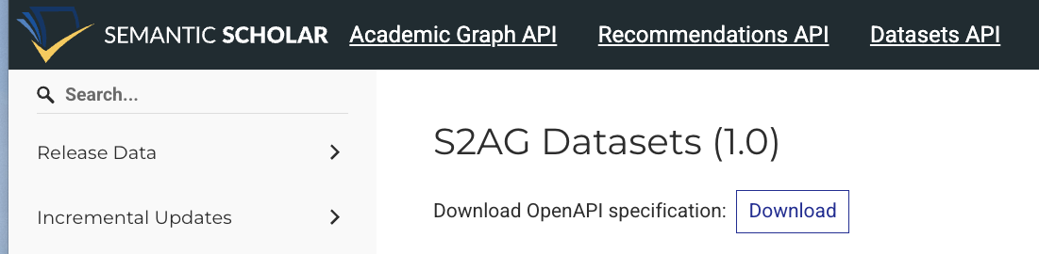
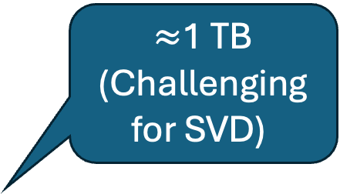
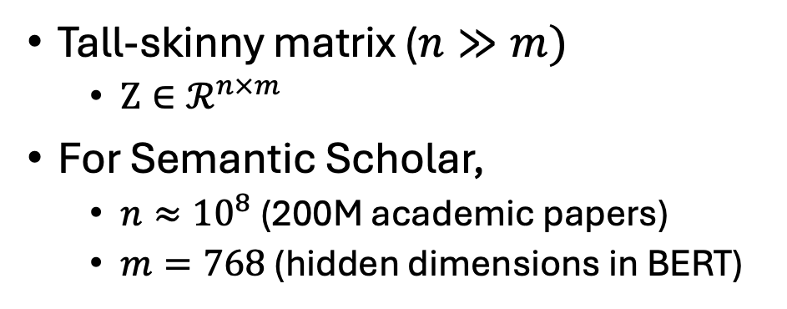
More embeddings you can download https://api.semanticscholar.org/api-docs/datasets http://recommendpapers.xyz (Recommend papers with ANN)
$≈$1 TB
(Challenging for SVD)
200M Academic Papers
Available:
API & Bulk Download
Many have titles, abstracts, vectors
PDFs for about 10%
Tall-skinny matrix ($n≫m)$
$Z∈ℛ^{n×m}$
For Semantic Scholar,
$n≈{10}^{8}$ (200M academic papers)
$m=768$ (hidden dimensions in BERT)

Slide 44
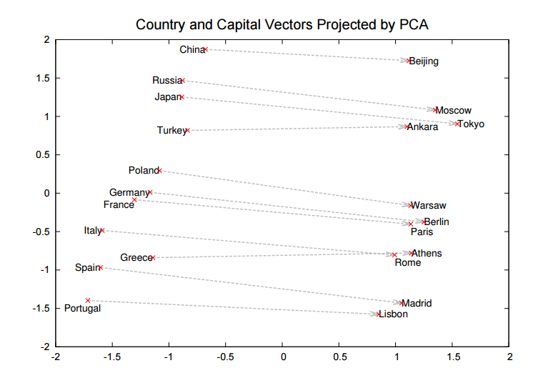
Refresher on Dimension Reduction (and Motivation for SVD)
Visualization
Need to map vectors
from many dimensions
down to 2D
Word2Vec
Each word is a vector of hundreds of numbers
How did they plot them in 2D?

Slide 45
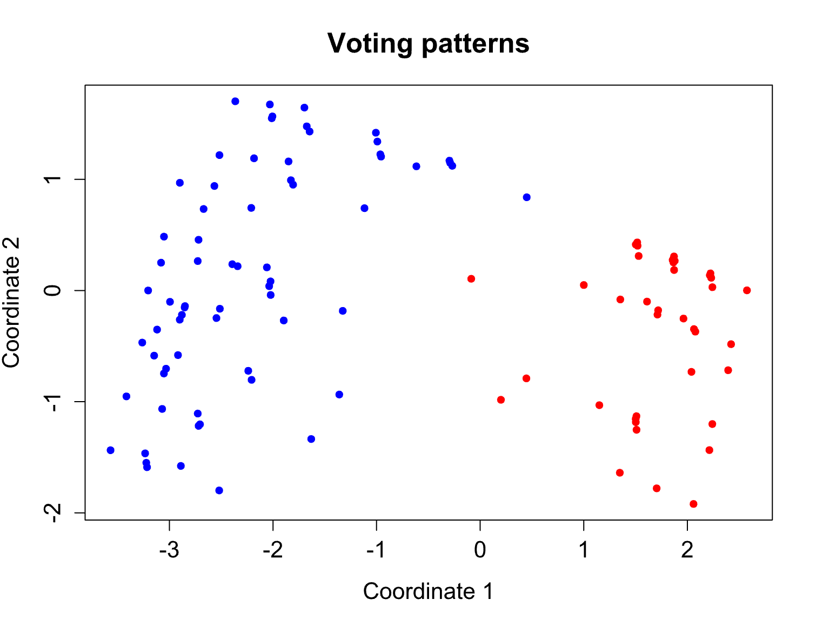
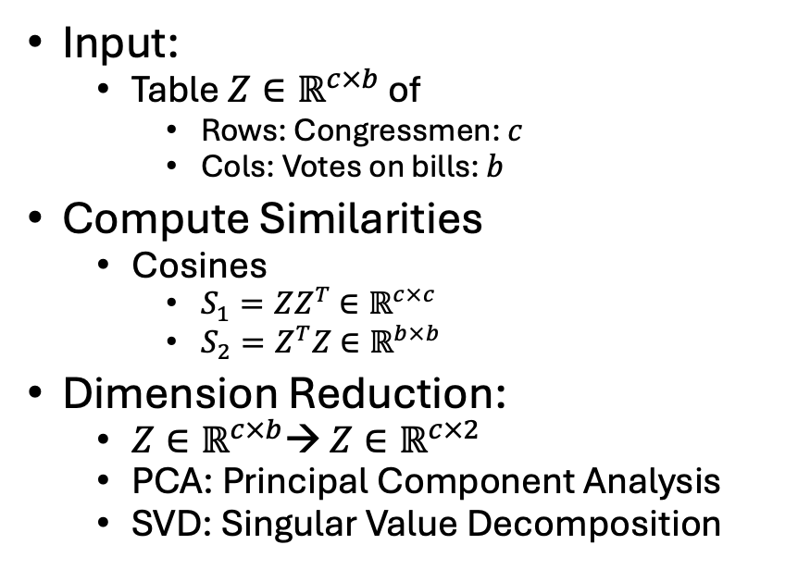
https://en.wikipedia.org/wiki/Multidimensional_scaling
Method
An example of classical multidimensional scaling applied to voting patterns in the United States House of Representatives. Each blue dot represents one Democratic member of the House, and each red dot one Republican.
Input:
Table $Z∈ℝ^{c×b}$ of
Rows: Congressmen: $c$
Cols: Votes on bills: $b$
Compute Similarities
Cosines
$S_{1}=ZZ^{T}$ $∈ℝ^{c×c}$
$S_{2}=Z^{T}Z$ $∈ℝ^{b×b}$
Dimension Reduction:
$Z∈ℝ^{c×b}$→ $Z∈ℝ^{c×2}$
PCA: Principal Component Analysis
SVD: Singular Value Decomposition
By Andrewman327 - Own work, CC BY 3.0, https://commons.wikimedia.org/w/index.php?curid=27273909

Slide 46
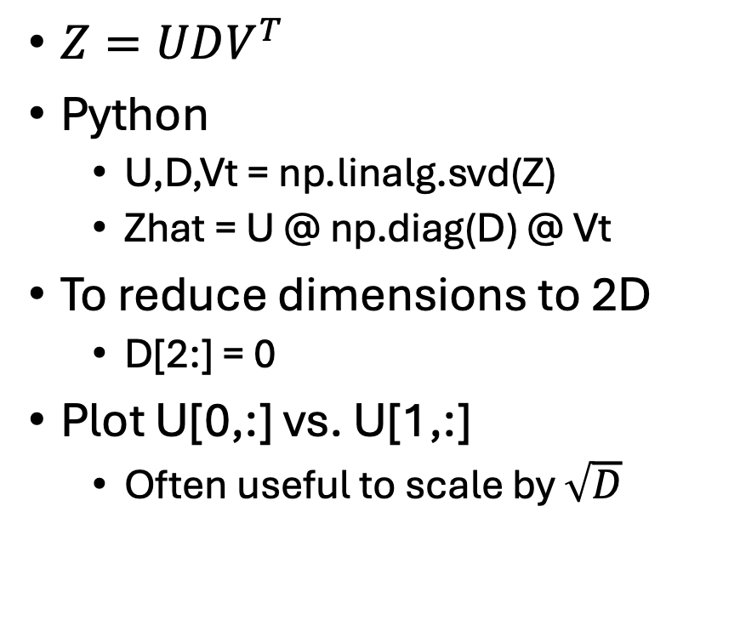
Singular Value Decomposition (SVD)
$Z=UDV^{T}$
Python
U,D,Vt = np.linalg.svd(Z)
Zhat = U @ np.diag(D) @ Vt
To reduce dimensions to 2D
D[2:] = 0
Plot U[0,:] vs. U[1,:]
Often useful to scale by $\sqrt{D}$

Slide 47
SVD: Extremely Important (though somewhat out of fashion recently)
Dimension Reduction
For visualization
For compression (first step in ANN)
Estimation of Intrinsic Dimensions
Lots of history/theory
Better understood than
PQ (Product-Quantization): A compression method used in ANN
Large Language Models (LLMs)
Spectral Clustering
Recommendation Systems:
Other people like you bought products like this

Slide 48
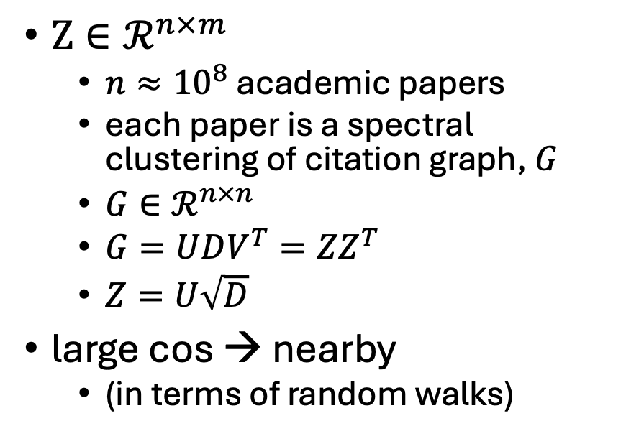
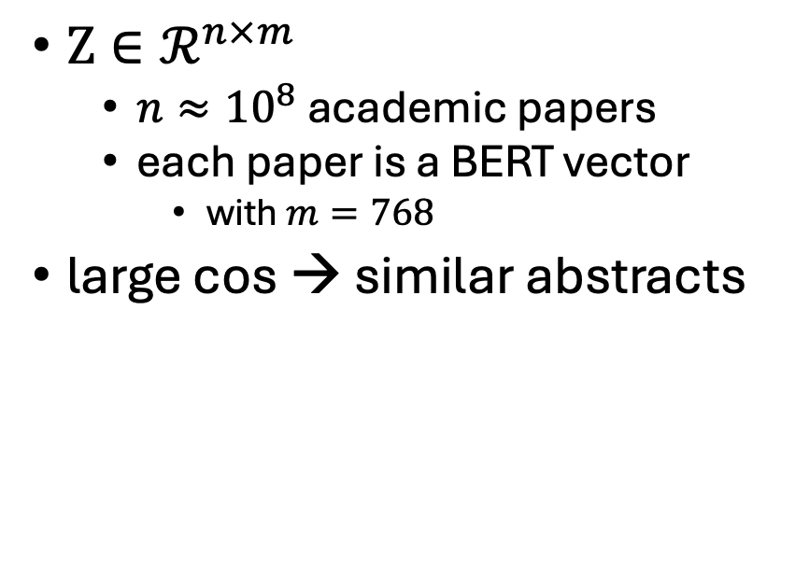
Better Together: More Motivation for SVD
BERT-like Embeddings of Papers
Spectral Clustering
Graph Embeddings of Citations
$Z∈ℛ^{n×m}$
$n≈{10}^{8}$ academic papers
each paper is a BERT vector
with $m=768$
large cos → similar abstracts
$Z∈ℛ^{n×m}$
$n≈{10}^{8}$ academic papers
each paper is a spectral clustering of citation graph, $G$
$Z=U\sqrt{D}$
large cos → nearby
(in terms of random walks)
Generalize to capture random walks

Slide 49
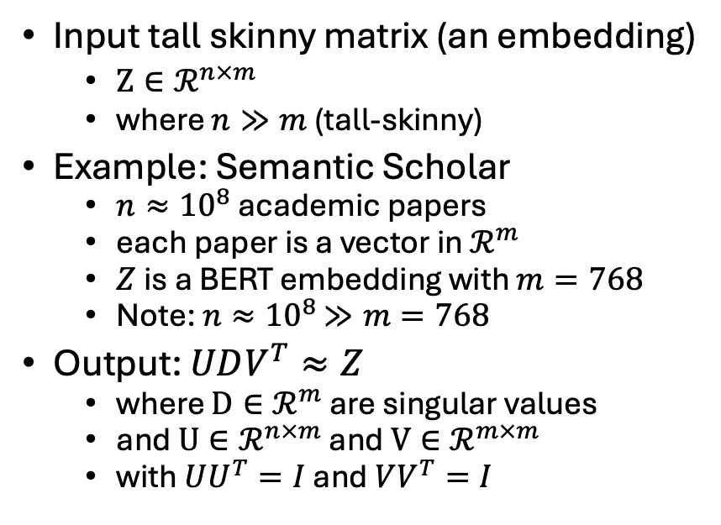
SVD of Tall Skinny Matrices (Large Language Models → Tall Skinny Embeddings)
LLMs, Sampling and SVD
SVD of a Tall-Skinny Matrix
Target: LLM for a Population of interest
Infinite set of input strings
Benchmarking/Evaluation
Sample of this space
To predict performance on pop of interest
Apply LLM to Sample → Embedding
SVD of Embedding
Well understood representation
Nuclear Norm: Sum of Singular Values
Intrinsic Dims/Compression for ANN
Embeddings are tall & skinny
Because |sample| >> hidden dimension
Input tall skinny matrix (an embedding)
$Z∈ℛ^{n×m}$
where $n≫m$ (tall-skinny)
Example: Semantic Scholar
$n≈{10}^{8}$ academic papers
each paper is a vector in $ℛ^{m}$
$Z$ is a BERT embedding with $m=768$
Note: $n≈{10}^{8}$ $≫m=768$
Output: $UDV^{T}≈Z$
where $D∈ℛ^{m}$ are singular values
and $U∈ℛ^{n×m}$ and $V∈ℛ^{m×m}$
with $UU^{T}=I$ and $VV^{T}=I$

Slide 50
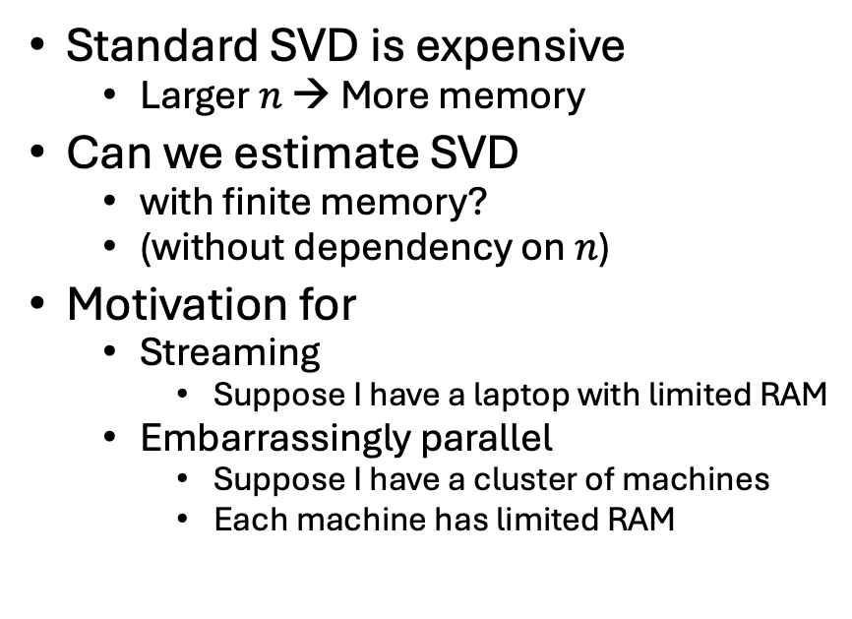
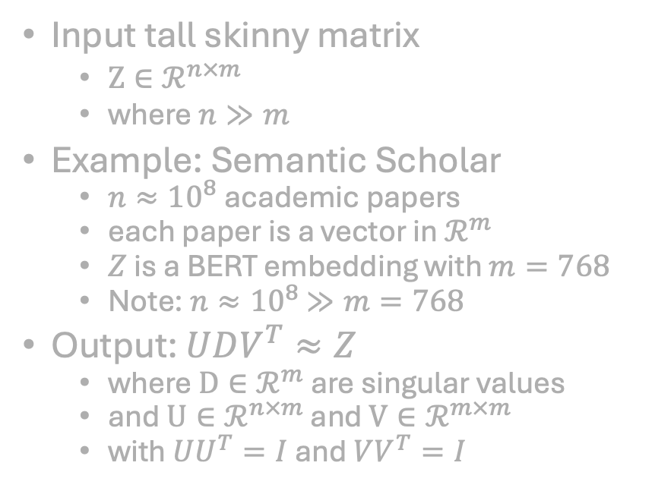
Streaming / Embarrassingly Parallel
SVD Problem
Motivation for Batching
Input tall skinny matrix
$Z∈ℛ^{n×m}$
where $n≫m$
Example: Semantic Scholar
$n≈{10}^{8}$ academic papers
each paper is a vector in $ℛ^{m}$
$Z$ is a BERT embedding with $m=768$
Note: $n≈{10}^{8}$ $≫m=768$
Output: $UDV^{T}≈Z$
where $D∈ℛ^{m}$ are singular values
and $U∈ℛ^{n×m}$ and $V∈ℛ^{m×m}$
with $UU^{T}=I$ and $VV^{T}=I$
Standard SVD is expensive
Larger $n$ → More memory
Can we estimate SVD
with finite memory?
(without dependency on $n$)
Motivation for
Streaming
Suppose I have a laptop with limited RAM
Embarrassingly parallel
Suppose I have a cluster of machines
Each machine has limited RAM

Slide 51
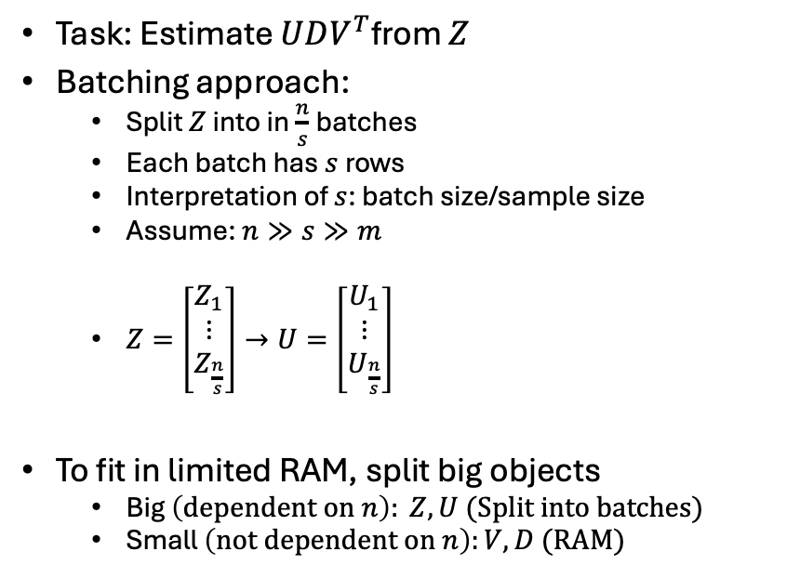
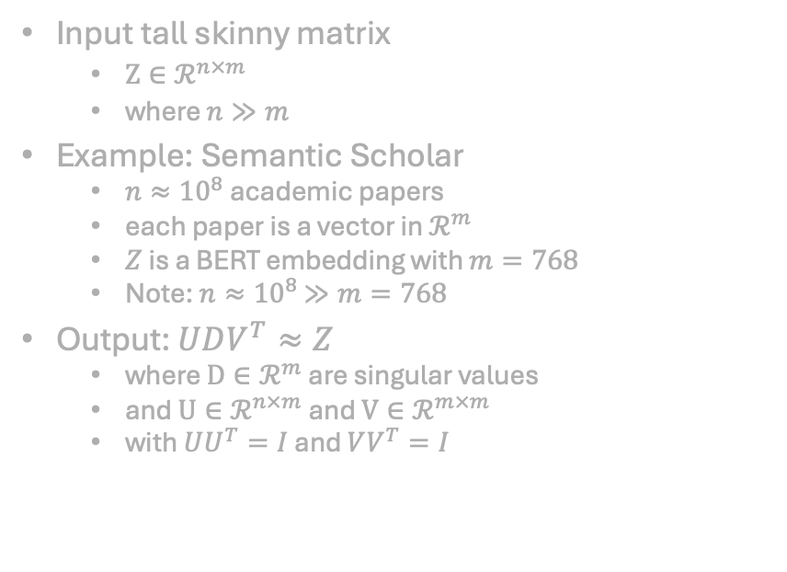
Batching & SVD
SVD Problem
Batching
Input tall skinny matrix
$Z∈ℛ^{n×m}$
where $n≫m$
Example: Semantic Scholar
$n≈{10}^{8}$ academic papers
each paper is a vector in $ℛ^{m}$
$Z$ is a BERT embedding with $m=768$
Note: $n≈{10}^{8}$ $≫m=768$
Output: $UDV^{T}≈Z$
where $D∈ℛ^{m}$ are singular values
and $U∈ℛ^{n×m}$ and $V∈ℛ^{m×m}$
with $UU^{T}=I$ and $VV^{T}=I$
Task: Estimate $UDV^{T}$from $Z$
Batching approach:
Split $Z$ into in $\frac{n}{s}$batches
Each batch has$s$rows
Interpretation of $s$: batch size/sample size
Assume: $n≫s≫m$
$Z=\left[\begin{matrix}Z_{1} \\ ⋮ \\ Z_{\frac{n}{s}}\end{matrix}\right]→U=\left[\begin{matrix}U_{1} \\ ⋮ \\ U_{\frac{n}{s}}\end{matrix}\right]$
To fit in limited RAM, split big objects
Big$\left(dependent on n\right): Z, U (Split into batches)$
Small $\left(not dependent on n\right):V, D (RAM)$

Slide 52
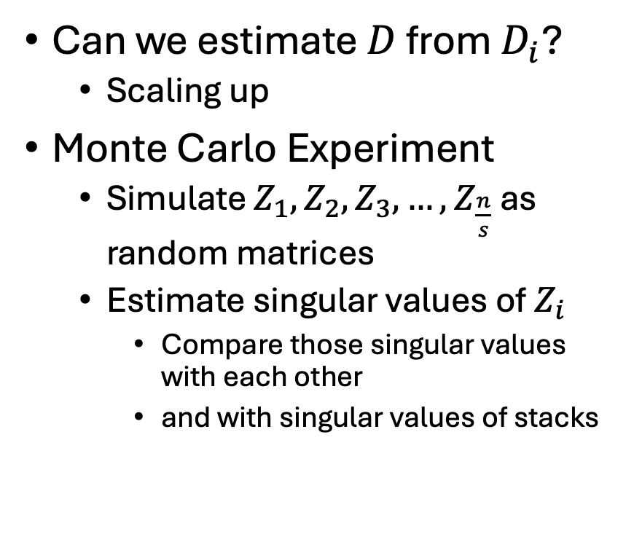
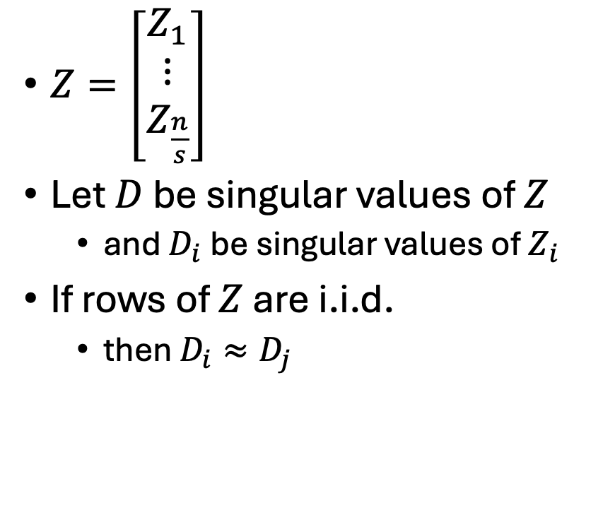
Crux: Estimate Singular Values from a Sample
$Z=\left[\begin{matrix}Z_{1} \\ ⋮ \\ Z_{\frac{n}{s}}\end{matrix}\right]$
Let $D$ be singular values of $Z$
and $D_{i}$be singular values of $Z_{i}$
If rows of $Z$ are i.i.d.
then $D_{i}≈D_{j}$
Can we estimate $D$ from $D_{i}$?
Scaling up
Monte Carlo Experiment
Simulate $Z_{1},Z_{2},Z_{3},…,$ $Z_{\frac{n}{s}}$ as random matrices
Estimate singular values of $Z_{i}$
Compare those singular values with each other
and with singular values of stacks

Slide 53
Monte Carlo Simulation in Python
import numpy as np
m=50 # hidden dimensions
s = 10*m # sample size
Z1 = np.random.random((s,m))
Z2 = np.random.random((s,m))
Z3 = np.random.random((s,m))
Z12 = np.vstack([Z1,Z2])
Z23 = np.vstack([Z2,Z3])
Z123 = np.vstack([Z1,Z2,Z3])
def svd(M):
return np.linalg.svd(M, full_matrices=False)
_,D1,_ = svd(Z1)
_,D2,_ = svd(Z2)
_,D3,_ = svd(Z3)
_,D12,_ = svd(Z12)
_,D23,_ = svd(Z23)
_,D123,_ = svd(Z123)

Slide 54
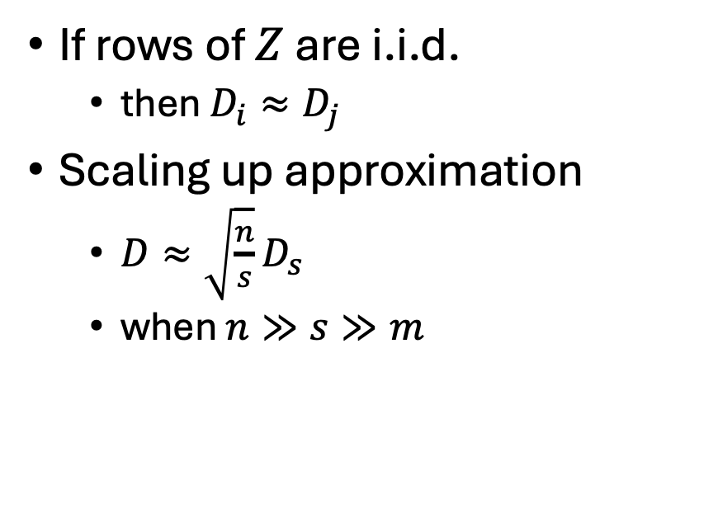
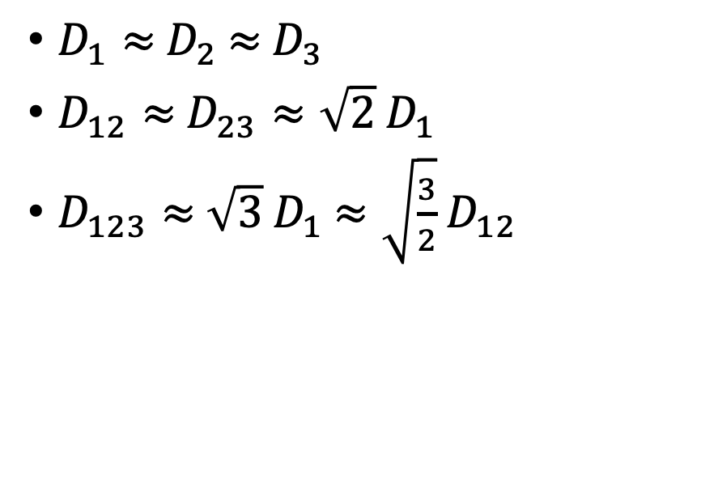
Monte Carlo Simulation in Python
Claims
Generalizations
$D_{1}≈$ $D_{2}$ $≈$ $D_{3}$
$D_{12}≈$ $D_{23}≈\sqrt{2}$ $D_{1}$
$D_{123}≈$ $\sqrt{3}$ $D_{1}$ $≈\sqrt{\frac{3}{2}}$ $D_{12}$
If rows of $Z$ are i.i.d.
then $D_{i}≈D_{j}$
Scaling up approximation
$D≈\sqrt{\frac{n}{s}}D_{s}$
when $n≫s≫m$

Slide 55

Monte Carlo Simulation in Python
Claims
Nuclear Norms
$D_{1}≈$ $D_{2}$ $≈$ $D_{3}$
$390.6 ≈390.44 ≈389.0$
$D_{12}≈$ $D_{23}≈\sqrt{2}$ $D_{1}$
$D_{123}≈$ $\sqrt{3}$ $D_{1}$ $≈\sqrt{\frac{3}{2}}$ $D_{12}$
for d in [D1,D2,D3]:
print(np.round(sum(d),2))
390.6
390.44
389.0

Slide 56

Monte Carlo Simulation in Python
Claims
Nuclear Norms
$D_{1}≈$ $D_{2}$ $≈$ $D_{3}$
$390.6 ≈390.44 ≈389.0$
$D_{12}≈$ $D_{23}≈\sqrt{2}$ $D_{1}$
555.22 $≈554.09≈552.39$
$D_{123}≈$ $\sqrt{3}$ $D_{1}$ $≈\sqrt{\frac{3}{2}}$ $D_{12}$
for d in [D12,D23,np.sqrt(2) * D1]:
print(np.round(sum(d),2))
555.22
554.09
552.39

Slide 57

Monte Carlo Simulation in Python
Claims
Nuclear Norms
$D_{1}≈$ $D_{2}$ $≈$ $D_{3}$
$390.6 ≈390.44 ≈389.0$
$D_{12}≈$ $D_{23}≈\sqrt{2}$ $D_{1}$
$555.22≈554.09≈552.39$
$D_{123}≈$ $\sqrt{3}$ $D_{1}$ $≈\sqrt{\frac{3}{2}}$ $D_{12}$
$680.38 ≈676.54 ≈680.01$
for d in [D123,np.sqrt(3) * D1,np.sqrt(3/2) * D12]:
print(np.round(sum(d),2))
680.38
676.54
680.01

Slide 58


Crux: Estimate Singular Values from a Sample
$Z=\left[\begin{matrix}Z_{1} \\ ⋮ \\ Z_{\frac{n}{s}}\end{matrix}\right]$
Let $D$ be singular values of $Z$
and $D_{i}$be singular values of $Z_{i}$
If rows of $Z$ are i.i.d.
then $D_{i}≈D_{j}$
Can we estimate $D$ from $D_{i}$?
Monte Carlo Experiment
Simulate $Z_{1},Z_{2},Z_{3},…,$ $Z_{\frac{n}{s}}$ as random matrices
Estimate singular values of $Z_{i}$
Compare those singular values with each other
and with singular values of stacks
$D≈\sqrt{\frac{n}{s}}D_{s}$ , if $n≫s≫m$
Larger $s$ → Slightly better approx

Slide 59


Comparison of $|\sqrt{2}$ $D_{1}|$ (lines) with ${|D}_{12}|$ (points) Conclusion: $\lim_{s→∞}{\sqrt{2} D_{1}→ D_{12}}$
More generally,
$D≈\sqrt{\frac{n}{s}}D_{s}$
when
$$n≫s≫m$$

Slide 60
Python for previous slide
import numpy as np
import sys
m = int(sys.argv[1])
def svd(M):
return np.linalg.svd(M, full_matrices=False)
def rand(dims):
return np.random.random(dims) - 0.5
print('m\ts\tnorm12\tnorm12hat')
for factor in range(500,1, -1):
do_factor(m, 1/factor)
for factor in range(1,500):
do_factor(m, factor)
def do_factor(m, factor):
s = int(m*factor)
if s < 5: return
Z1 = rand((s,m))
Z2 = rand((s,m))
Z12 = np.vstack([Z1,Z2])
_,D1,_ = svd(Z1)
_,D2,_ = svd(Z2)
_,D12,_ = svd(Z12)
norm12 = np.sum(D12)
norm12hat = np.sqrt(2) * np.sum(D1)
print('\t'.join(map(str, [m, s, norm12, norm12hat])))

Slide 61



Summary: SVD with Batching
Batching
Method
Task: $Z = U D V^{T}$
$\text{Input} Z$
$\text{Output}\text{:} U, D, V^{T}$
$\text{Assume}\text{:}$
$U_{i}DV_{}^{T}= Z_{i}$
$V^{T}≈ V_{s}^{T} \text{and} D≈\sqrt{\frac{n}{s}}D_{s}$
Split $Z$and $U$ into batches
where $U_{i}$is a batch of $s$ rows of $U$
and $Z_{i}$is a batch of $s$ rows of $Z$
Knowns: $D{, V}_{}^{T}\&$ $Z_{i}$
Unknown: $U_{i}$
Solve $U_{i}DV_{}^{T}= Z_{i}$for $U_{i}$
That is, $U_{i}=$ $Z_{i}$ $V_{}D^{−1}$
Batches easily fit in RAM (independent of $n$)
$Z_{i}$ $∈ℛ^{s×m}$
${ U}_{i}$ $∈ℛ^{s×m}$
${ V}_{s} ∈ℛ^{s×m}$
$D∈ℛ^{m}$
Because $n≫s≫m$
$s$ and $m$ are small
$n$ is not
Code is here:
https://github.com/kwchurch/JSALT_Better_Together/blob/main/src/streaming_svd.py

Slide 62
Agenda: Connecting Dots From PMI to Bots (and back to sampling)
PMI → Word2Vec → Bots
Bots
Thesaurus Application
Lexical Semantics
An Embarrassing Parallel Approximation for SVD
Sampling: Lesson from Past
Valuable lessons from past
Current excitement in AI
Everything is new (???)
Hypo:
strong connections what’s hot now
and what was hot in 1990s
and what was hot in 1950s
Spoiler Alert: This is a good time to revisit sampling

Slide 63

Random Sampling is All You Need (?)
Yes
No
$D≈\sqrt{\frac{n}{s}}D_{s}$
SVD:
You can estimate $D$ from sample
Good enough when: $n≫s≫m$
Tiny $s$ since $m$ is not large
m: hidden dimensions of LLM
Benchmarking:
Sample is good enough
to tell you how LLM will perform
on infinite set of population of interest
(all possible inputs)
Benchmark should be bigger than $m$
FLORES (NLLB)
Set of all possible inputs
includes many minorities
(special cases)
Many of these special cases are
too rare to matter
in a small sample (benchmark)
Sampling
Benchmarking and SVD
do not capture rare cases
We need to listen more to minorities
Rare cases are too important to ignore
Random sampling → Stratification

Slide 64

Stratify Semantic Scholar By Language, Field of Study, Venue, etc.
200M Academic Papers
Available:
API & Bulk Download
Many have titles, abstracts, vectors
PDFs for about 10%
Many papers are in English
But many are in many languages
LID (language id): CLD3

Slide 65



Using Nuclear Norms to Compare Monolingual and Multilingual LLMs
260 Nuclear Norms
$$260=2×26×5$$
Monolingual
Multilingual

Slide 66

Using Nuclear Norms to Compare Monolingual and Multilingual LLMs
$$260=2×26×5$$
Reliability
Repeatability
5 Batches: Boxes → Lines
Interesting diffs over LLMs
Interesting diffs over lang

Slide 67

Hypothesis: Bigger is Better
Best argument: Calibration
Intuition:
Specter has larger nuclear norms for English than other languages
Why?
Specter is intended for English
Inappropriate for other languages

Slide 68

Random Sampling is All You Need (?)
Yes
No
$D≈\sqrt{\frac{n}{s}}D_{s}$
SVD:
You can estimate singular values and SVD from sample
Good enough: $n≫s≫m$
$m$: hidden dimensions of LLM
Benchmarking:
Sample is good enough to tell you how LLM will perform on infinite set of all possible inputs
Set of all possible inputs
includes many minorities
(special cases)
Many of these special cases are
too rare to to appear
in a small sample
Sampling
(benchmarking and SVD)
does not capture rare cases
Rare cases are too important
to ignore
Stratification → Chinese (corner cases)

Slide 69

Conclusions
Bots
Thesaurus Application
Sampling: Lesson from Past
PMI → Word2Vec → Bots
An Embarrassing Parallel Approximation for SVD
$D≈\sqrt{\frac{n}{s}}D_{s}$
Strong connections to past
Plus lots of recent advances
This is a good time to revisit sampling
All you need is sampling?
Yes
Benchmarking
SVD
No
Don’t ignore rare (corner) cases
Stratification → Chinese, etc.

Slide 70
Agenda
Bots
Predictability
PMI & Lexicography
Lexical Semantics: With and Without Embeddings
PMI: Pointwise Mutual Information
PMI → Word2Vec → Bots

Slide 71

Semantics → Embeddings PMI → Word2Vec → Bots
Lexical Semantics
Synonyms: $x=y$
Antonyms: $x≠y$
Hypernyms (is-a): $x<y$
a car is a vehicle
Vectors/Embeddings:
More modern view of meaning
Behind much of the recent excitement in AI
Large Language Models (LLM)
Bots: ChatGPT, DeepSeek
Equivalence Relation
Partial Order

Slide 72



Google Trends for “Kennedy”: Queries over 12 months (7/24-7/25)
Election

Slide 73
Testable Hypotheses
Benefits of ChatBot technology are particularly helpful for certain classes of users:
Group subjects by size of
Active Vocabulary and/or
Passive Vocabulary
Group subjects by age
Group subjects by education
L1 (native speakers)
vs L2
Second language speakers
Non-native speakers
Language learners

Slide 74
Brown Corpus: Influential over many fields
Brown Corpus: widely cited over many fields:
Information Retrieval
Baeza-Yates and Ribeiro-Neto (1999)
Lexicography
Miller (1995)
Sociolinguistics
Biber (1991)
Psychology
MacWhinney (2000)
Computational Linguistics
Marcus et al (1993)
Jurafsky and Martin (2000)
Church and Hanks (1990)
Resnik (1995)
6/27/2014
Fillmore Workshop
74

Slide 75


What if sample is too small?
Replace $n≫s≫m$
with $n≫m≫s$
then $D≫\sqrt{\frac{n}{s}}D_{s}$
$D_{1}≈$ $D_{2}$ $≈$ $D_{3}$
$D_{12}≈$ $D_{23}≫\sqrt{2}$ $D_{1}$
$D_{123}≫$ $\sqrt{\frac{3}{2}}$ $D_{12}$ $≫$ $\sqrt{3}$ $D_{1}$

Slide 76


Q: What if sample is too small? A: Scaling up → Large errors (underestimates)
m=50; s=500
m=50; s=5
(s is too small)
$D_{1}≈$ $D_{2}$ $≈$ $D_{3}$
$390.6 ≈390.44 ≈389.0$
$D_{12}≈$ $D_{23}≈\sqrt{2}$ $D_{1}$
$555.22≈554.09≈552.39$
$D_{123}≈\sqrt{\frac{3}{2}}$ $D_{12}$ $≈$ $\sqrt{3}$ $D_{1}$
$680.38 ≈680.01$ $≈676.54$
$D_{1}≈$ $D_{2}$ $≈$ $D_{3}$
$16.65 ≈16.71≈16.14$
$D_{12}≈$ $D_{23}≈\sqrt{2}$ $D_{1}$
$30.28 ≈29.74 ≫23.54$
$D_{123}≈\sqrt{\frac{3}{2}}$ $D_{12}$ $≈$ $\sqrt{3}$ $D_{1}$
$42.1 ≫38.08 ≫28.83$

Slide 77

Larger Samples → Less Error (Less Scaling Up → Less Error)
m=50; s=500
m=50; s=5000
(s is larger than necessary)
$D_{1}≈$ $D_{2}$ $≈$ $D_{3}$
$390.6 ≈390.44 ≈389.0$
$D_{12}≈$ $D_{23}≈\sqrt{2}$ $D_{1}$
$555.22≈554.09≈552.39$
$D_{123}≈\sqrt{\frac{3}{2}}$ $D_{12}$ $≈$ $\sqrt{3}$ $D_{1}$
$680.38 ≈680.01$ $≈676.54$
$D_{1}≈$ $D_{2}$ $≈$ $D_{3}$
1248.44 $≈$ 1249.68 $≈$ 1249.8
$D_{12}≈$ $D_{23}≈\sqrt{2}$ $D_{1}$
$1767.42≈1768.3≈1765.56$
$D_{123}≈\sqrt{\frac{3}{2}}$ $D_{12}$ $≈$ $\sqrt{3}$ $D_{1}$
$2165.45≈2164.64≈2162.35$

Slide 78


Burstiness/
Contagious
Freq depends on many hidden variables
Deviations from Chance → “Interesting”
Sheds light on hidden variables

Slide 79

PMI: Pointwise Mutual Information
JM: Chapter 6 (especially 6.6)
Word Association Norms, Mutual Information, and Lexicography
https://aclanthology.org/J90-1003/

